Slide 1



TAITH
AFON
RIVER MONITORING
WORKSHOP SLIDES

Slide 2

TAITH
AFON
BY THE END OF THIS WORKSHOP, WE WILL...
Be able to visually identify types of water pollution
Understand where different pollutions come from
Identify prevention methods to protect a rivers’ health

Slide 3


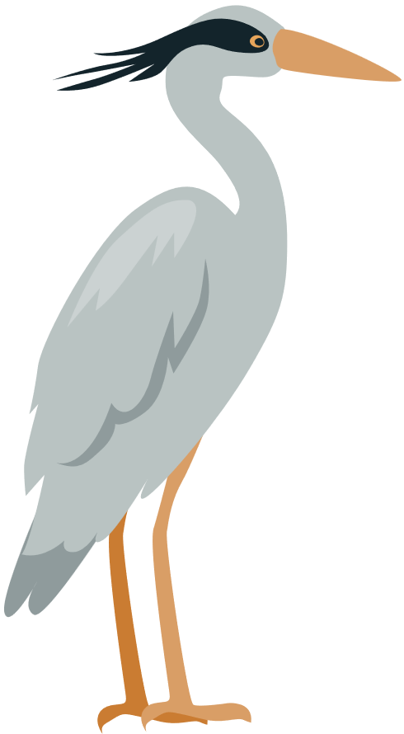




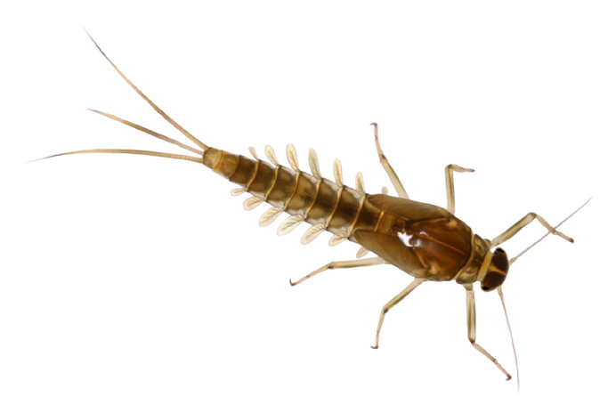
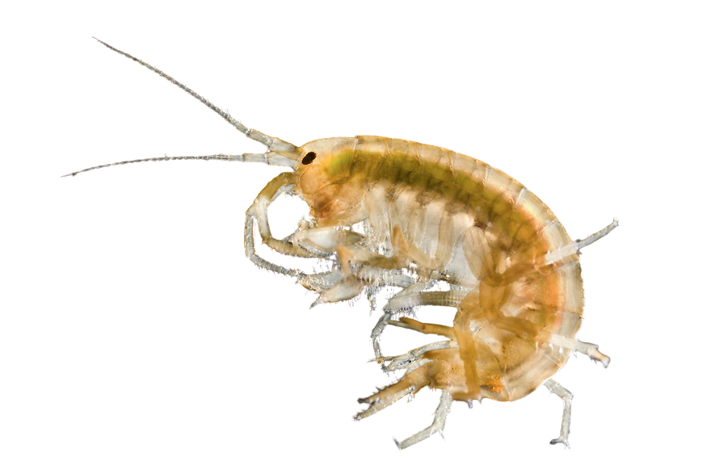
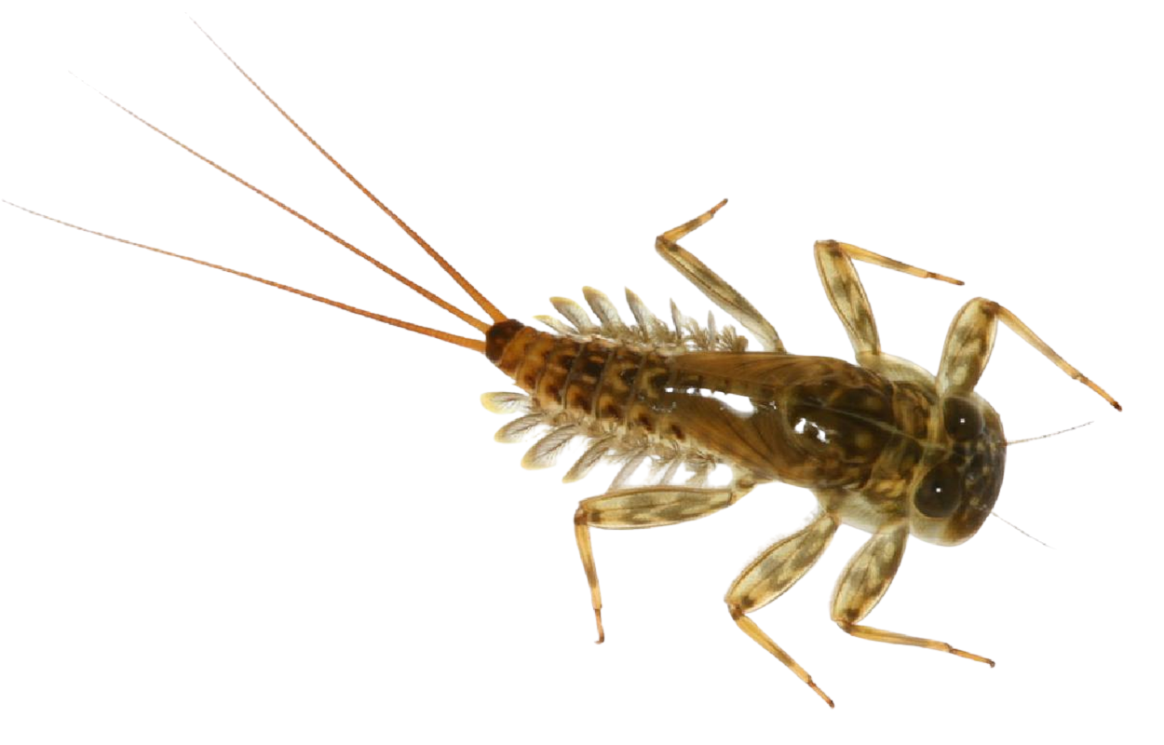
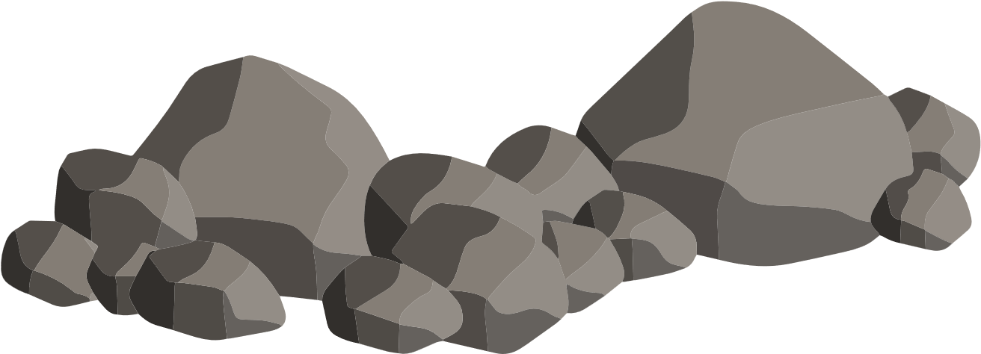
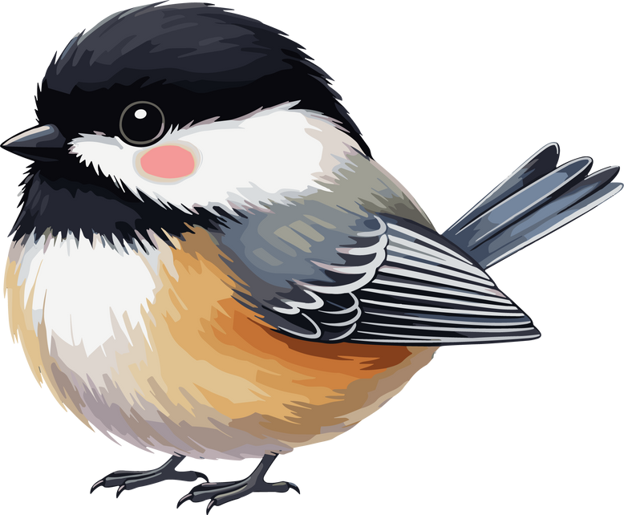
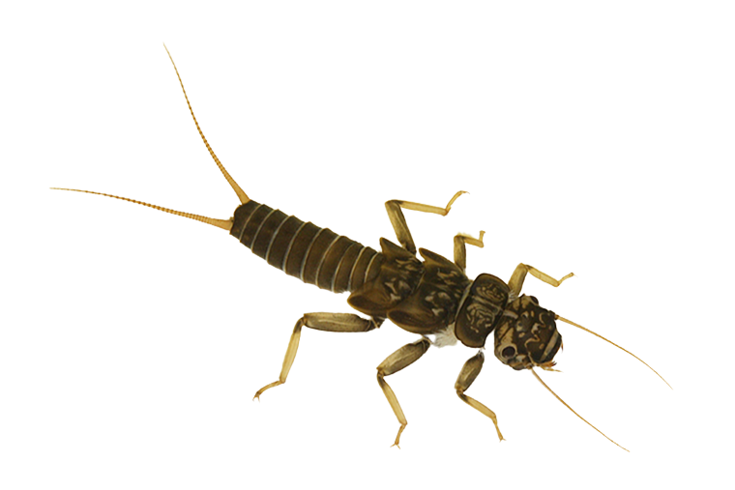
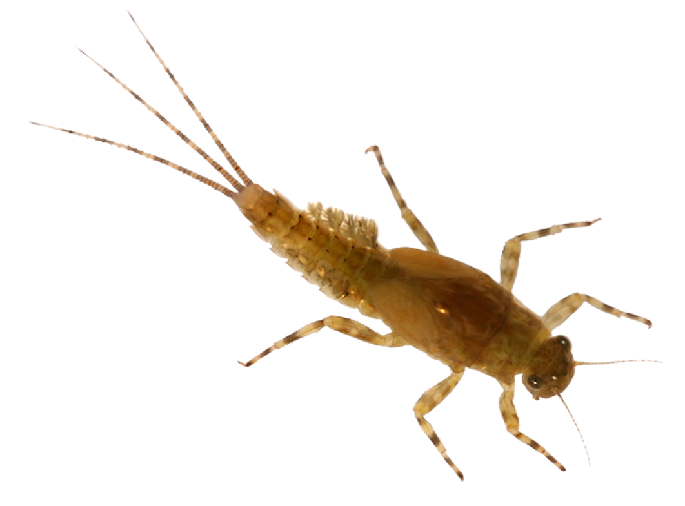
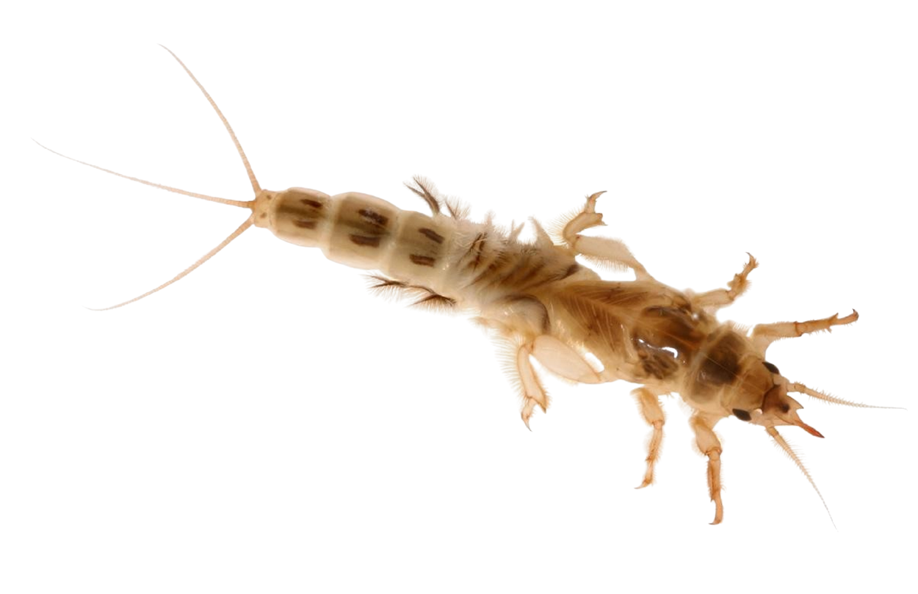
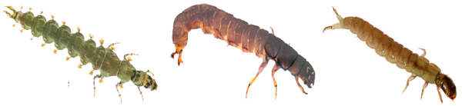
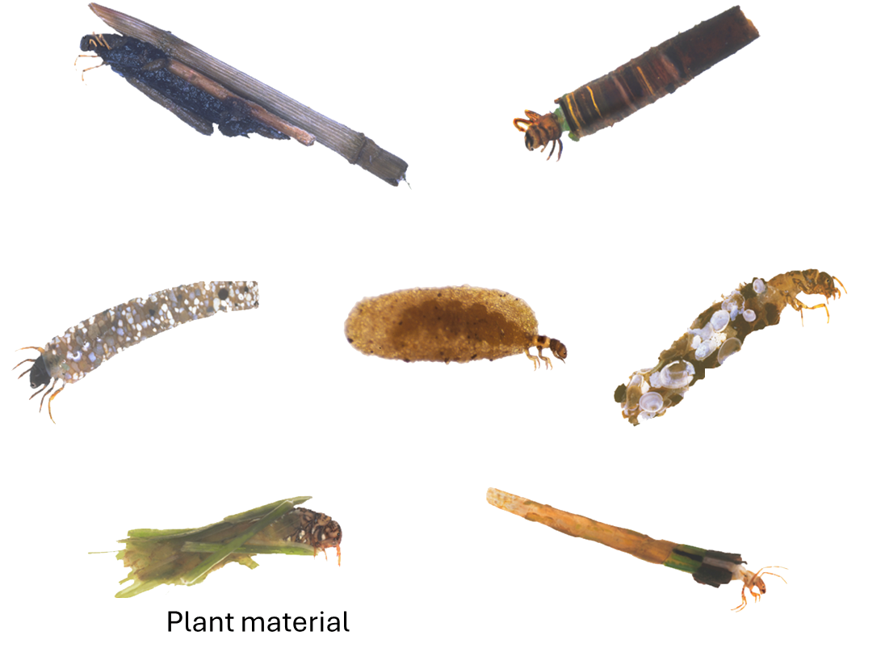

TAITH
AFON

Slide 4




TAITH
AFON

Slide 5
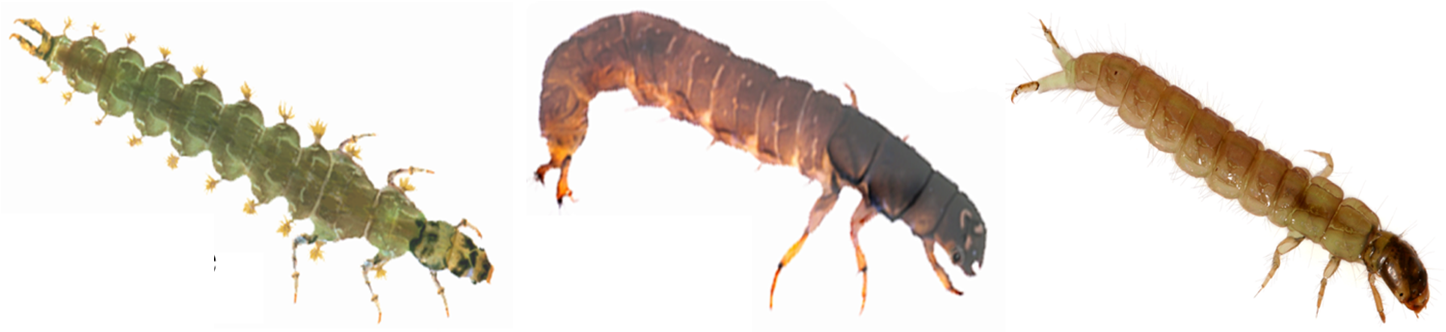
OUR 7 KEY RIVER INVERTEBRATES
TAITH
AFON

Slide 6

WHAT DO THESE 7 INVERTEBRATES LOOK LIKE?
TAITH
AFON
TOP TIP:
Tails and legs are going to be key features to help us

Slide 7
STONEFLY
TAITH
AFON
2 long tails
3 pairs of legs
2 long antenna

Slide 8
FLAT BODIED UPWING
TAITH
AFON
3 long tails
Powerful, flattened legs
Large feather gills that stick out sideways
Broad, flattened head

Slide 9

FLAT BODIED UPWING
TAITH
AFON
3 long tails
RESEMBLES?
Powerful, flattened legs
Large feather gills that stick out sideways
Broad, flattened head

Slide 10
OLIVE
TAITH
AFON
3 tails, sometimes the middle is shorter
Sometimes they have stripey legs
8 gills that stand up on their back
Long, thin back legs
Distinctive head seperation from body

Slide 11
MAYFLY
TAITH
AFON
Short, powerful legs with strong claws
Feathery gills across back
Tusk-like mouth parts

Slide 12
CASELESS CADDIS
TAITH
AFON
Mid-section missing legs
Two short tails with tiny hooks
Visible mouthparts
Very small gills, barely visible

Slide 13
CASED CADDIS
TAITH
AFON
Wood
Sand
Stones
Shells
Plant material

Slide 14
FRESHWATER SHRIMP
TAITH
AFON
Curved bodyshape
Extra appendages
Many legs

Slide 15
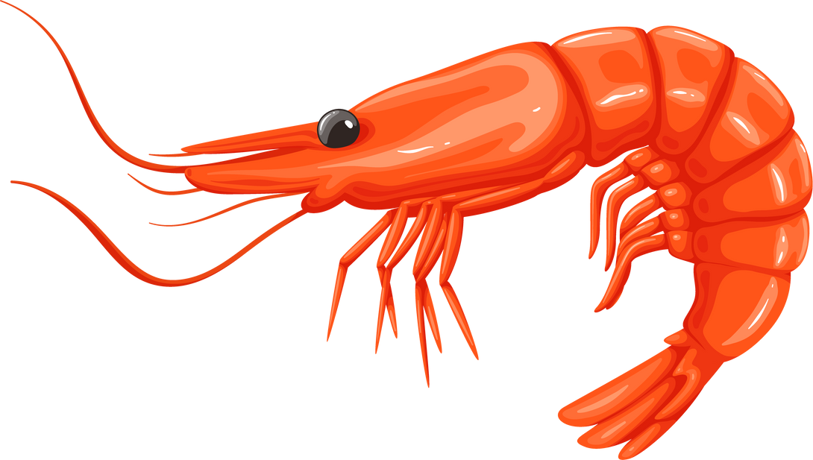
FRESHWATER SHRIMP
TAITH
AFON
RESEMBLES?
Curved bodyshape
Extra appendages
Many legs

Slide 16
FRESHWATER SHRIMP
TAITH
AFON
RESEMBLES?
Curved bodyshape
Extra appendages
Many legs

Slide 17
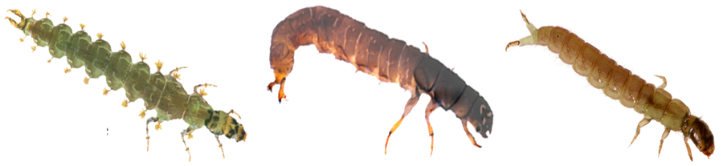
POLLUTION SENSITIVITY SCALE
TAITH
AFON
MOST SENSITIVE
LEAST SENSITIVE

Slide 18
FINDING THE INVERTEBRATES
TAITH
AFON
Where do the river invetebrates live?

Slide 19

FINDING THE INVERTEBRATES
TAITH
AFON
Where do our invetebrates live?
Under the rocks at the bottom!

Slide 20

FINDING THE INVERTEBRATES
TAITH
AFON
How are we going to get them into our nets?

Slide 21

FINDING THE INVERTEBRATES
TAITH
AFON
We are going to use out feet to move the rocks and gravel around so that the invertebrates flow downstream into our net.

Slide 22
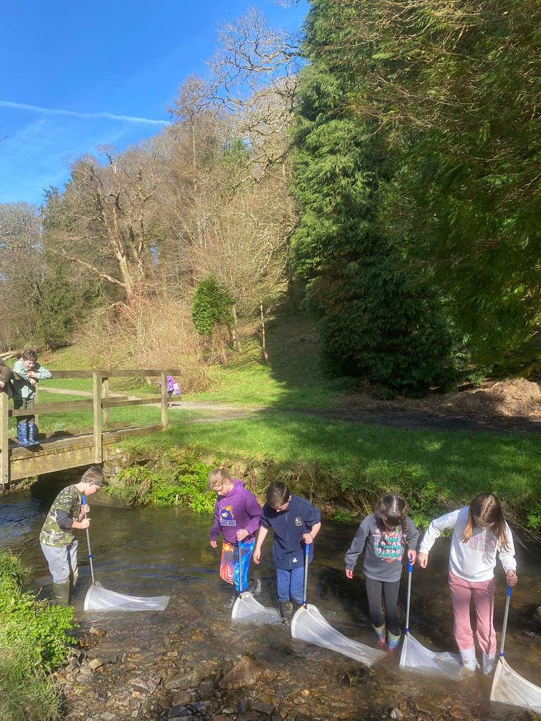

AT THE RIVER - PREPARATION
TAITH
AFON
Being by a river can be a dangerous environment. So its important that:
You are very aware and cautious of your
surroundings
You take note of how deep is the water is
before entering
You find a safe, flat gradient entry point

Slide 23
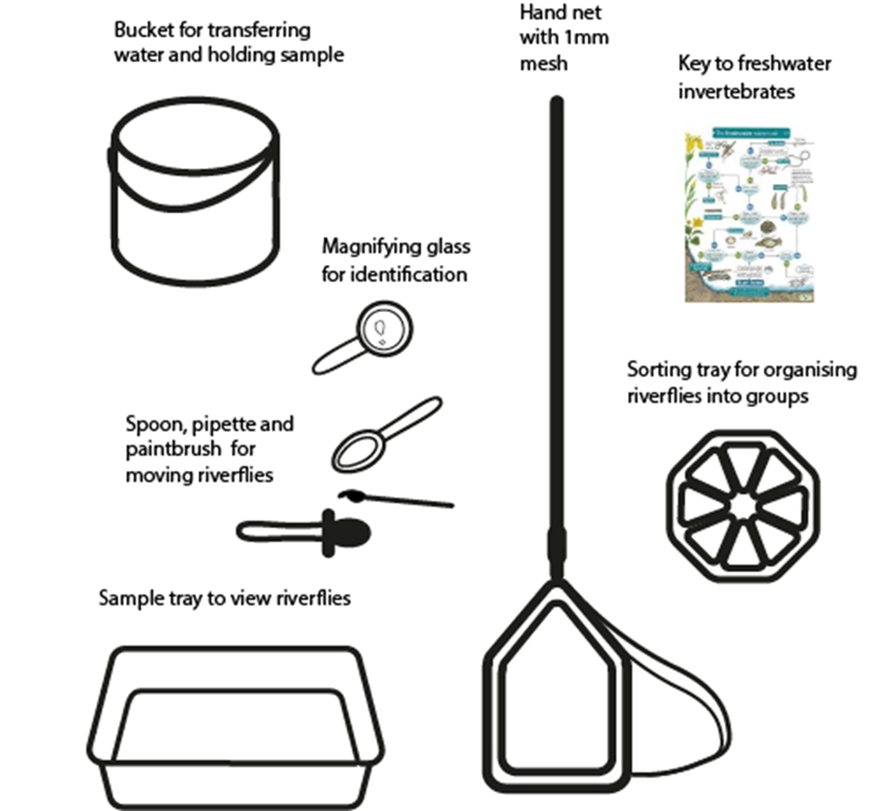
AT THE RIVER - PREPARATION
TAITH
AFON
Get your kit ready on flat ground away
from the river.
You’ll need these items per group:
1 Bucket (dont forget to put some river water in it before you get your sample - not too much!)
1 flat tray and 1 8-part sorting tray
1 spoon, paitinbrush or turkey baster per person
Any ID guides

Slide 24
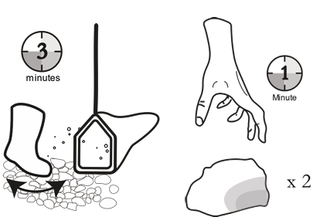
COLLECTING YOUR SAMPLE
TAITH
AFON
Head into the river - no deeper than ankle deep (or you’ll get wet!)
Place the net downstream of you and hold on tight.
Stand directly infront of your net as though you were blocking the entrance.
When instructed and the timer starts, begin digging a hole with your feet into the bottom of the river, moving the substraight out the way.

Slide 25
COLLECTING YOUR SAMPLE
TAITH
AFON
Head into the river - no deeper than ankle deep (or you’ll get wet!)
Place the net downstream of you and hold on tight.
Stand directly infront of your net as though you were blocking the entrance.
When instructed and the timer starts, begin digging a whole with your feet into the bottom of the river, moving the substraight out the way.
TOP TIP:
Don’t kick rocks and stones into the net!

Slide 26
COLLECTING YOUR SAMPLE
TAITH
AFON
Once the time is up, pick up your net and take it to your groups bucket.
Empty your net into your bucket. You’ll need to use your hands to scrape all the bugs off carefully into the water.
Double check that all living things have come off your net, then rinse your net in the river before passing it to the next person.

Slide 27

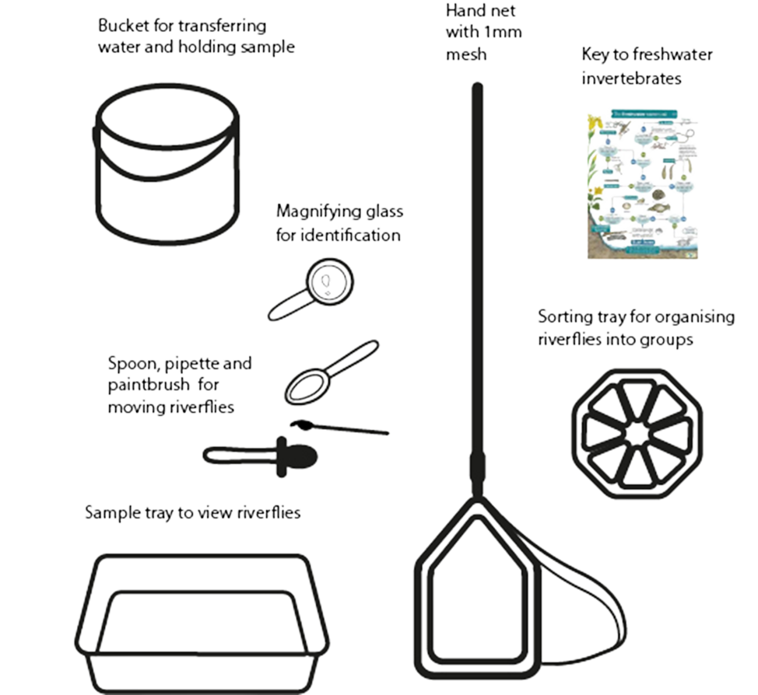
SORTING YOUR SAMPLE
TAITH
AFON
Take your bucket of bugs to your tray. (This will be heavy so you may need to ask an adult).
Emptythe contents of your bucket very slowly and carefully into your flat tray. Make sure not to fill your tray too high, or spill your bugs everywhere.
Now you have your sample in your tray you can put your ID skills to use and start sorting your bugs into the correct sorting compartment in your sorting tray.

Slide 28
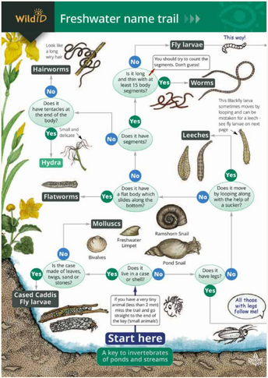
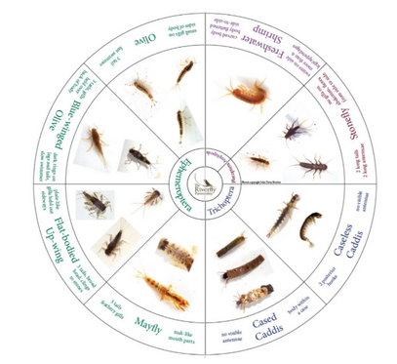

SORTING YOUR SAMPLE
TAITH
AFON
Use your ID guides to help you identify which invertebrate you’ve got,
Use your paintbrushes and spoons to transfer the bugs into the correct compartment.
Don’t forget to put water into your sorting tray using your turkey baster!

