Slide 1


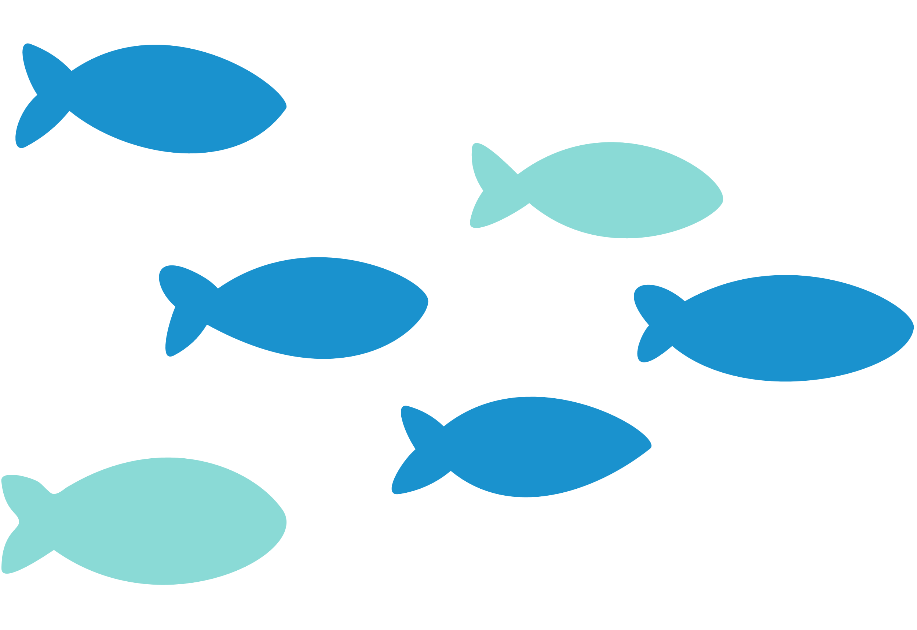
TAITH
AFON
RIVER HEALTH
WORKSHOP SLIDES

Slide 2
TAITH
AFON
BY THE END OF THIS WORKSHOP, WE WILL...
Be able to visually identify types of water pollution
Understand where different pollutions come from
Identify prevention methods to protect a rivers’ health

Slide 3
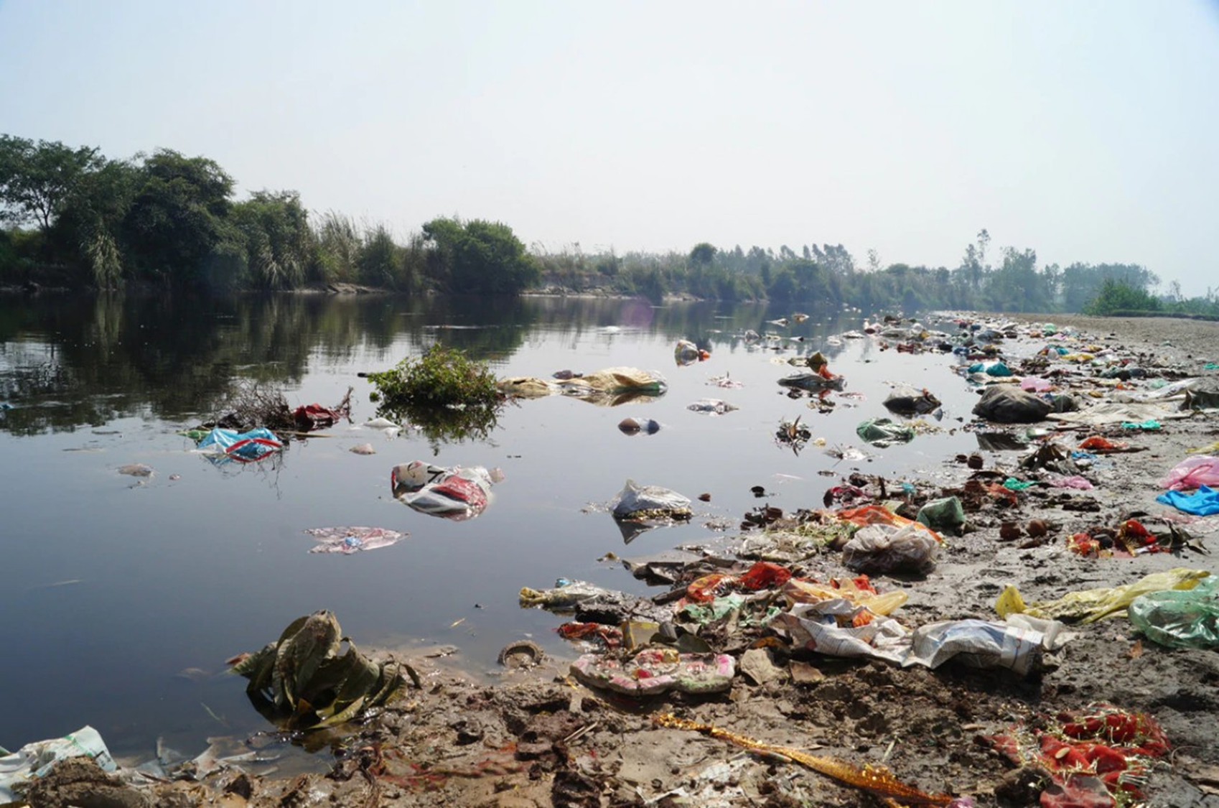
Is this a healthy river?
TAITH
AFON

Slide 4
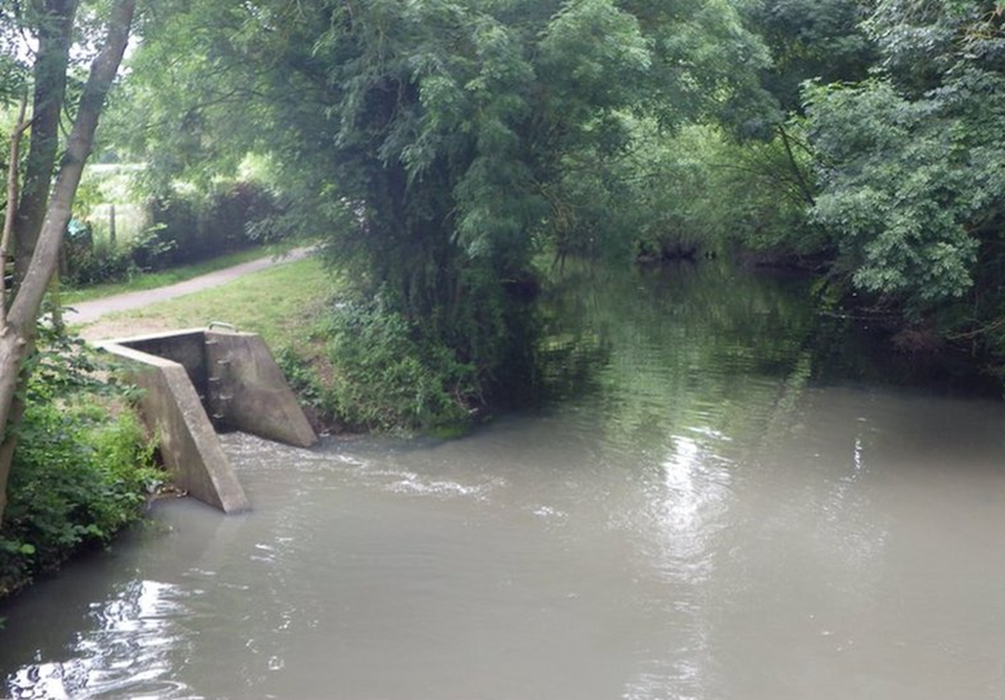
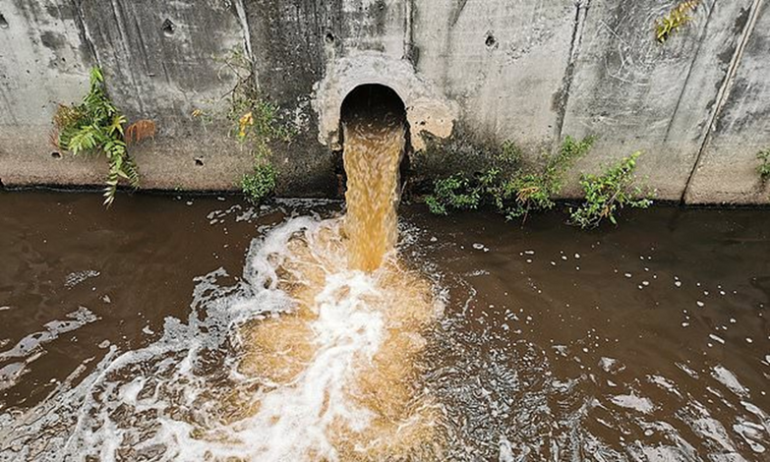
Is this a healthy river?
TAITH
AFON

Slide 5
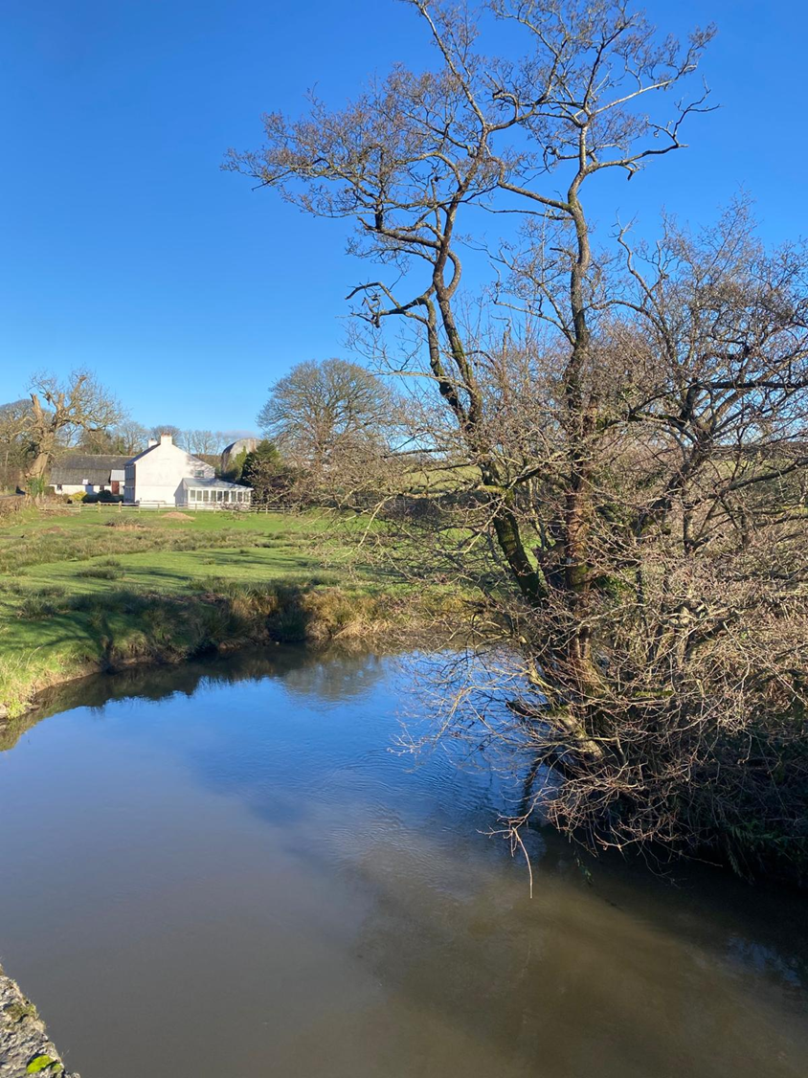
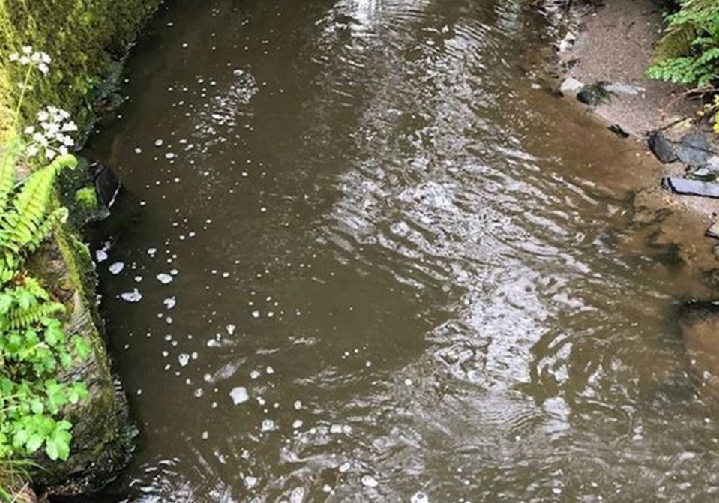
Is this a healthy river?
TAITH
AFON

Slide 6
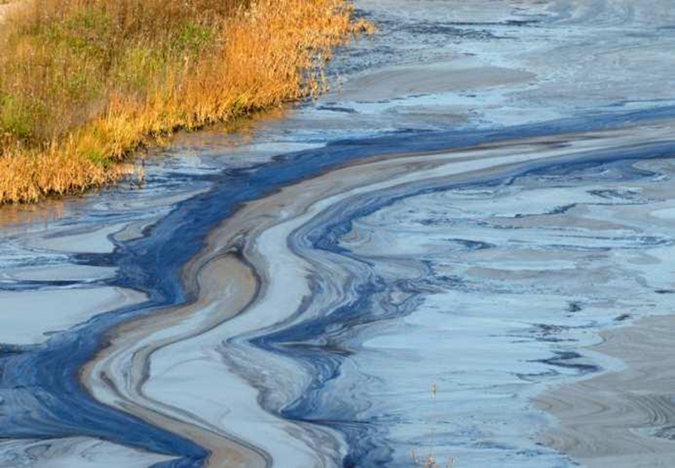
Is this a healthy river?
TAITH
AFON

Slide 7
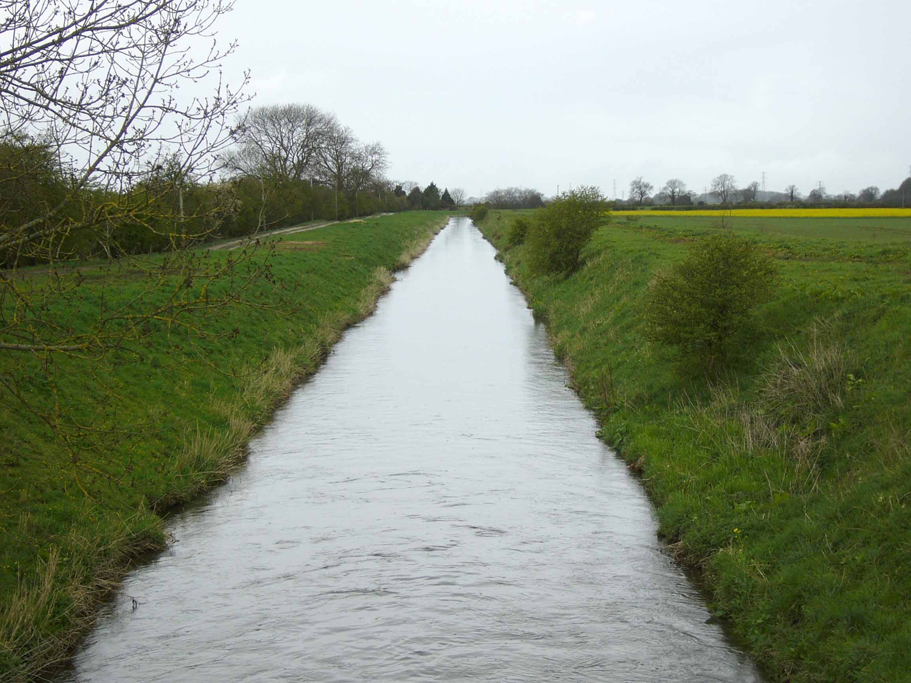
Is this a healthy river?
TAITH
AFON

Slide 8
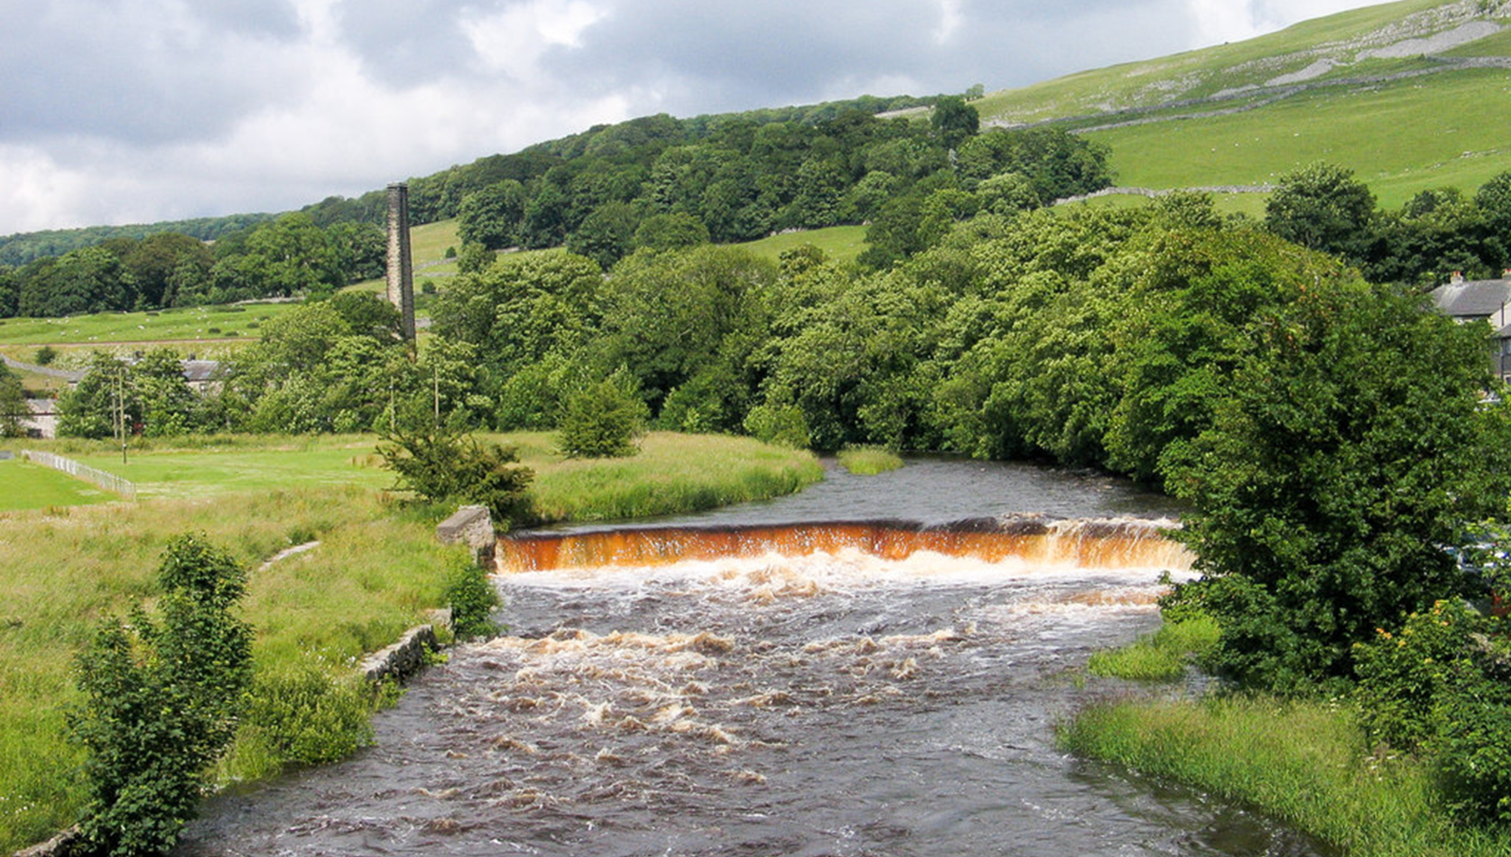
Is this a healthy river?
TAITH
AFON

Slide 9
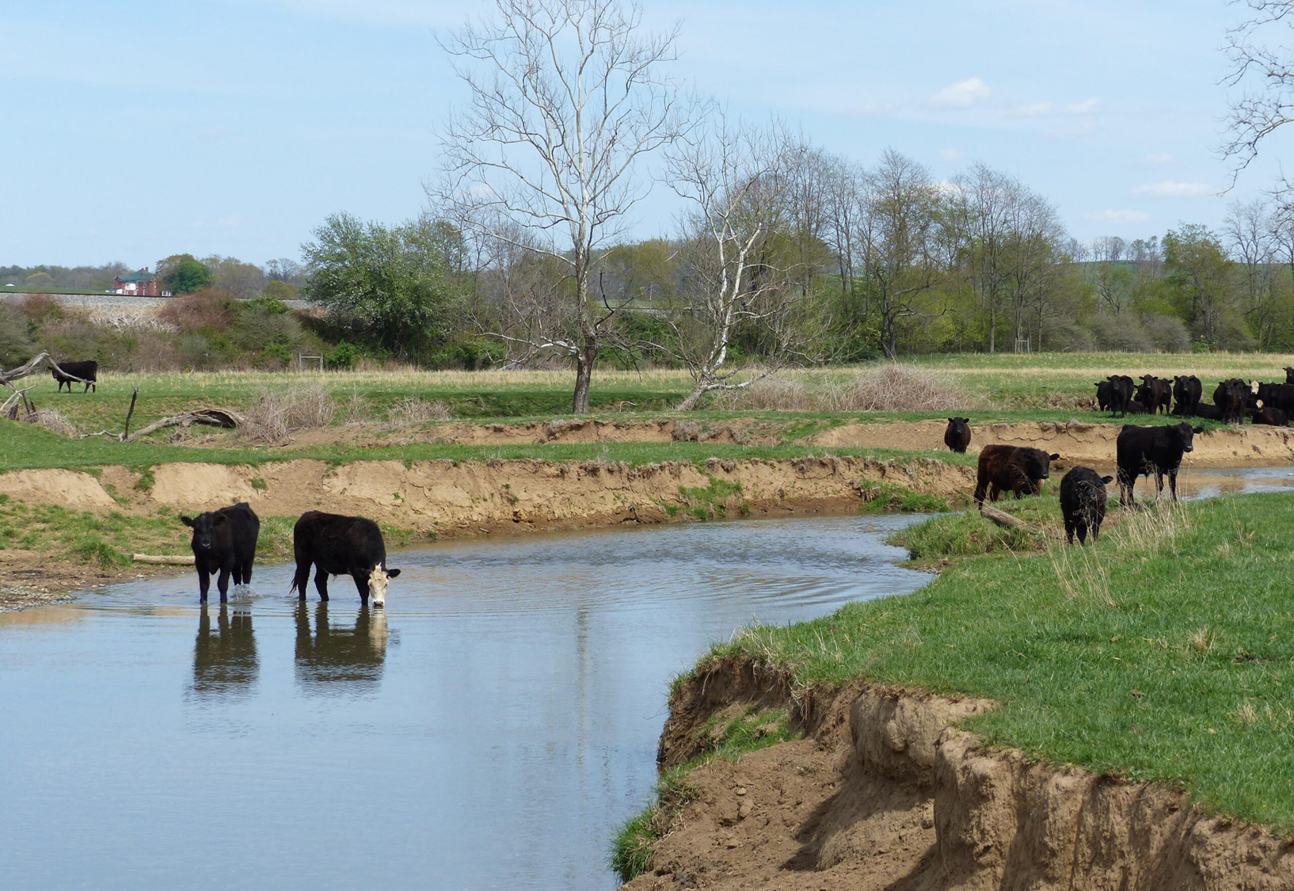
Is this a healthy river?
TAITH
AFON

Slide 10
ACTIVITY
TAITH
AFON
Its time for you to protect your river...

Slide 11
STRETCH ACTIVITY
TAITH
AFON
Group 1- Fly Tipping: https://www.bbc.co.uk/news/articles/ckgn81v485vo
Group 2 - Chemical Spill: https://www.dailymail.co.uk/news/article-1170187/Theriver-bubble-bath-Mountain-foam-floats-downstream-suspected-chemical-spillsoap-factory.html
Group 3 - Sewage: https://www.bbc.co.uk/future/article/20240704-the-wetlandscleaning-up-the-uks-sewage-pollution
Group 4 - Agriculture: https://www.mirror.co.uk/news/uk-news/british-riversfilled-almost-34000-34053164
What impact does the incident have on the river’s health? Think water quality and wildlife.
How could this incident have been prevented?
Who is responsible for preventing this from happening again?

Slide 12

TAITH
AFON
Now we can…
Visually identify types of water pollution
Understand where different pollutions come from
Identify prevention methods to protect a rivers’ health

