Slide 1



TAITH
AFON
RIVER ECOSYSTEMS
WORKSHOP SLIDES

Slide 2
TAITH
AFON
BY THE END OF THIS WORKSHOP, WE WILL...
Visually identify some river species
Understand the life-cycle of some key river species
Understand how species are connected to create our river ecosystem

Slide 3
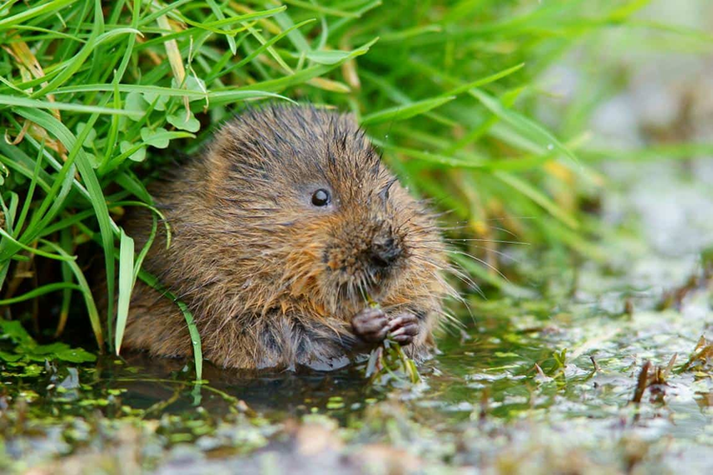
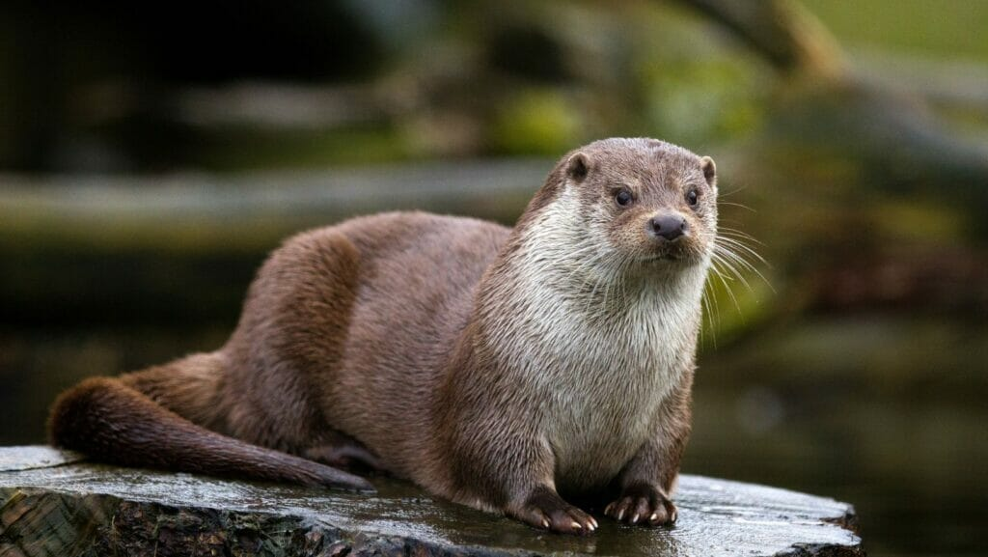
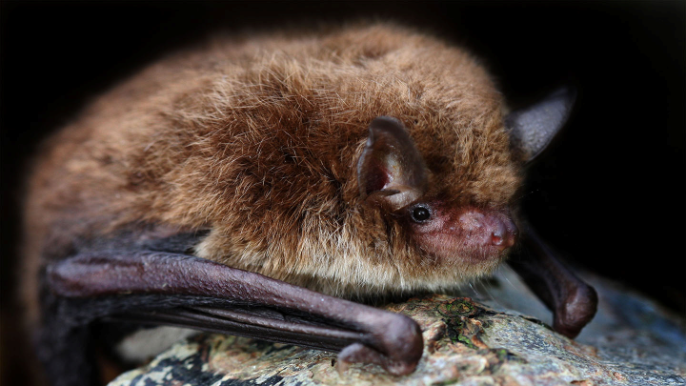
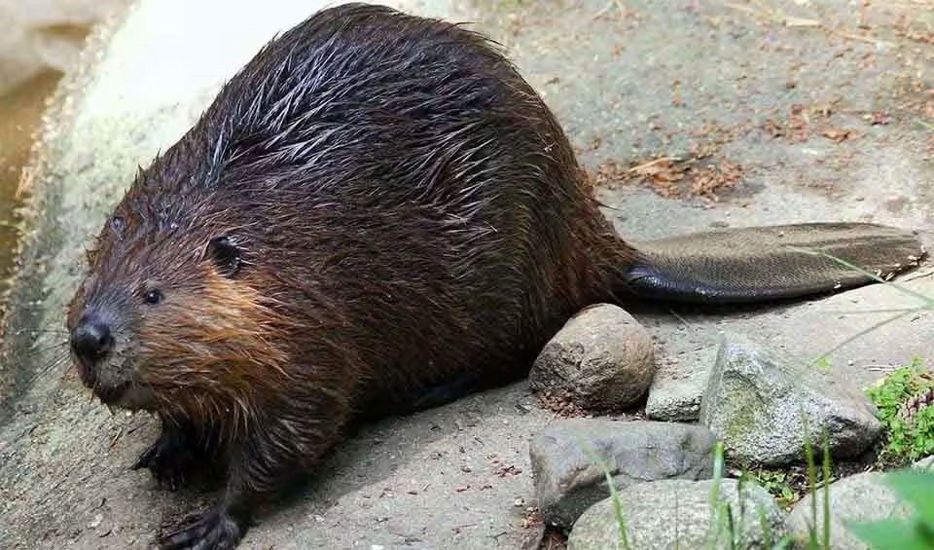
MAMMALS
TAITH
AFON

Slide 4
MAMMALS
TAITH
AFON
WATER VOLE

Slide 5
MAMMALS
TAITH
AFON
EURASIAN OTTER

Slide 6
MAMMALS
TAITH
AFON
DAUBENTONS BAT

Slide 7
MAMMALS
TAITH
AFON
EURASIAN BEAVER

Slide 8
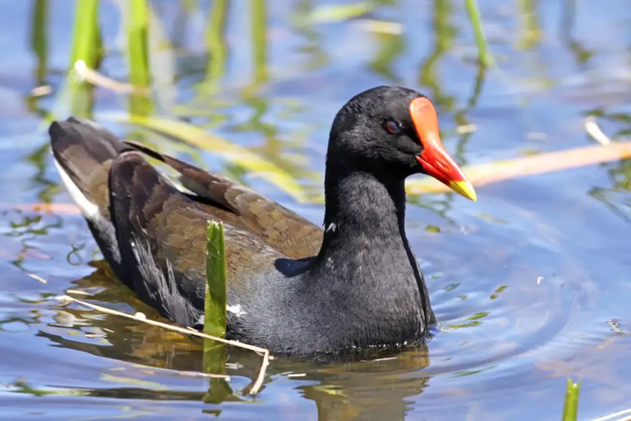
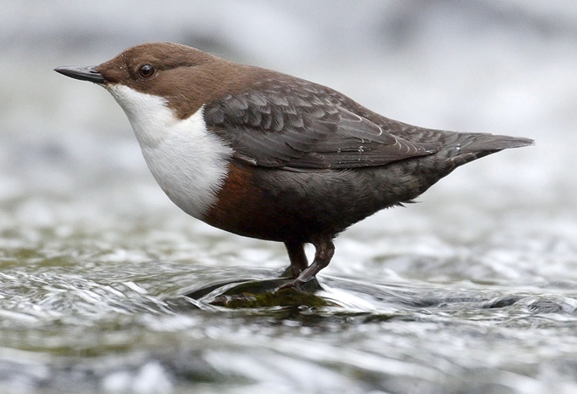
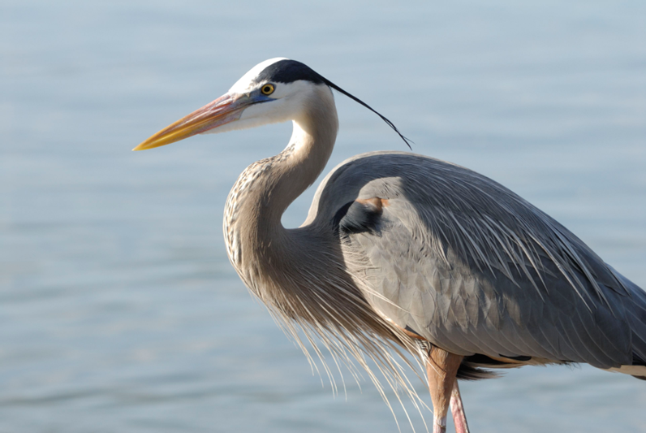
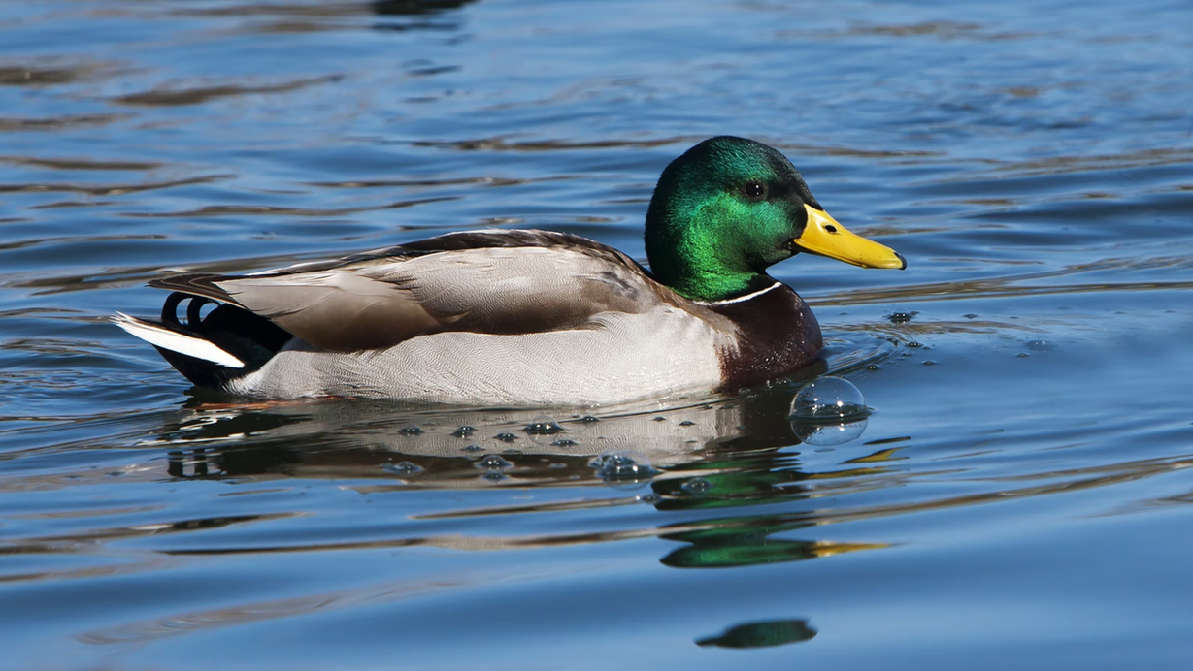
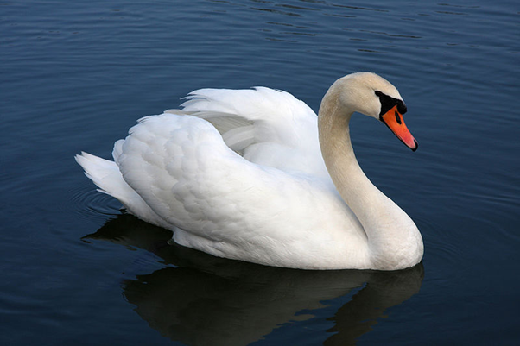
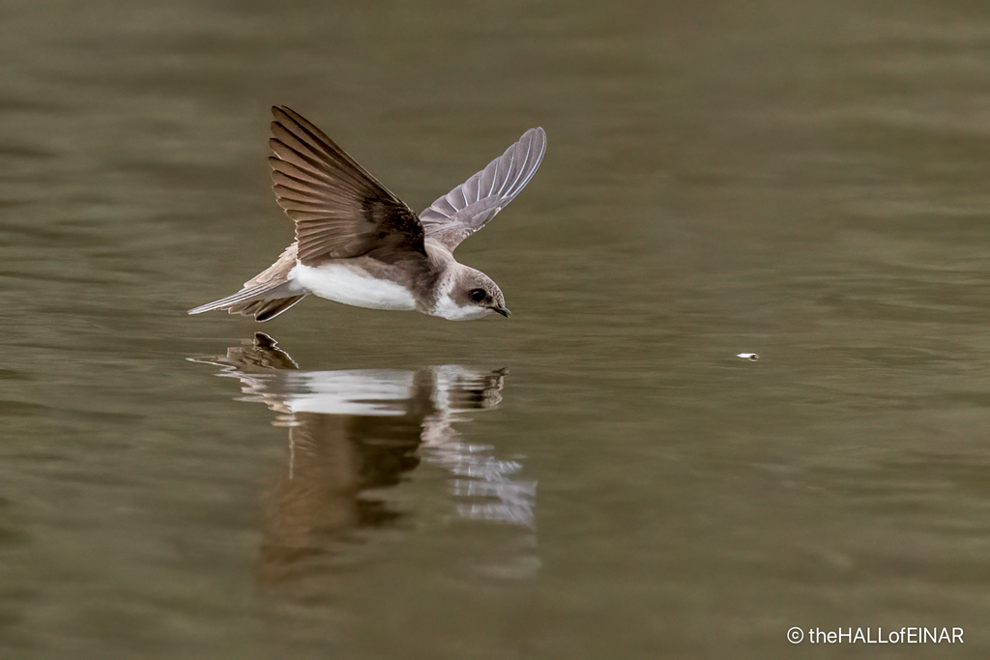
BIRDS
TAITH
AFON

Slide 9
BIRDS
TAITH
AFON
COMMON MOORHEN

Slide 10
BIRDS
TAITH
AFON
DIPPER

Slide 11
BIRDS
TAITH
AFON
GREY HERON

Slide 12
BIRDS
TAITH
AFON
MALLARD DUCK

Slide 13
BIRDS
TAITH
AFON
MUTE SWAN

Slide 14
BIRDS
TAITH
AFON
SAND MARTIN

Slide 15
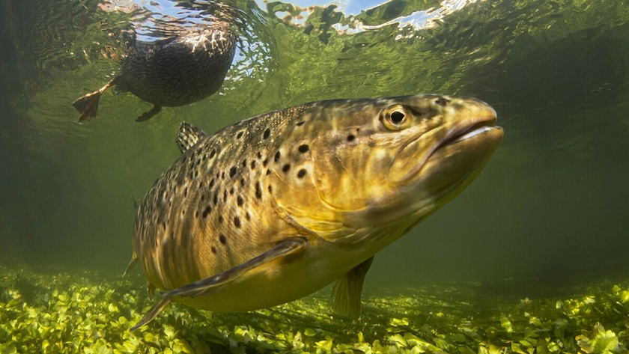
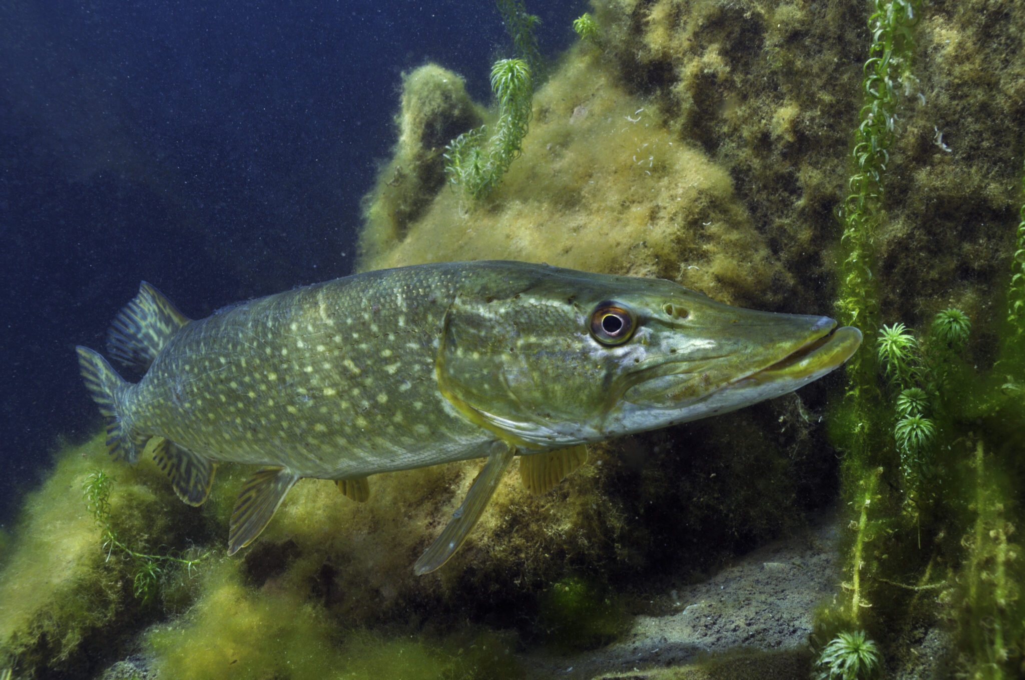
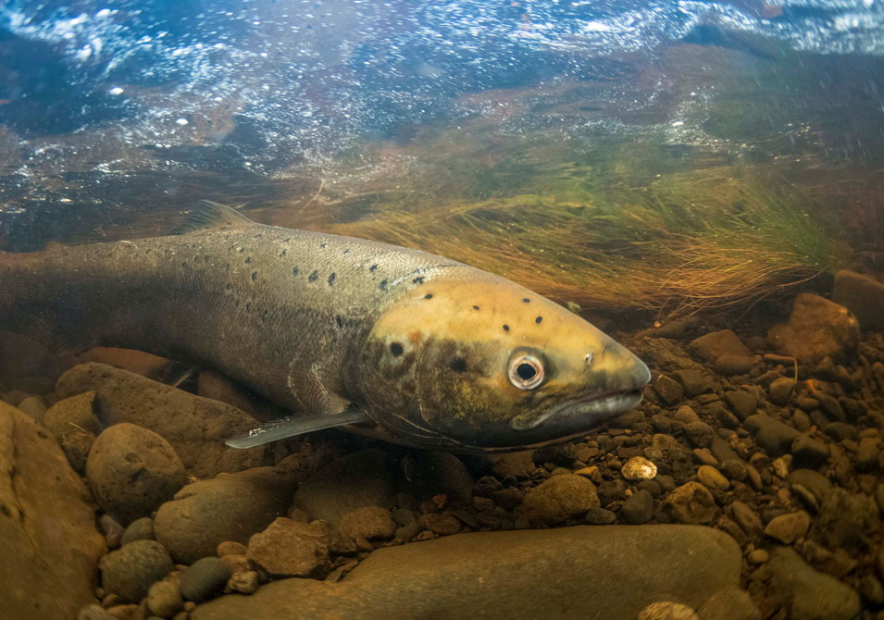
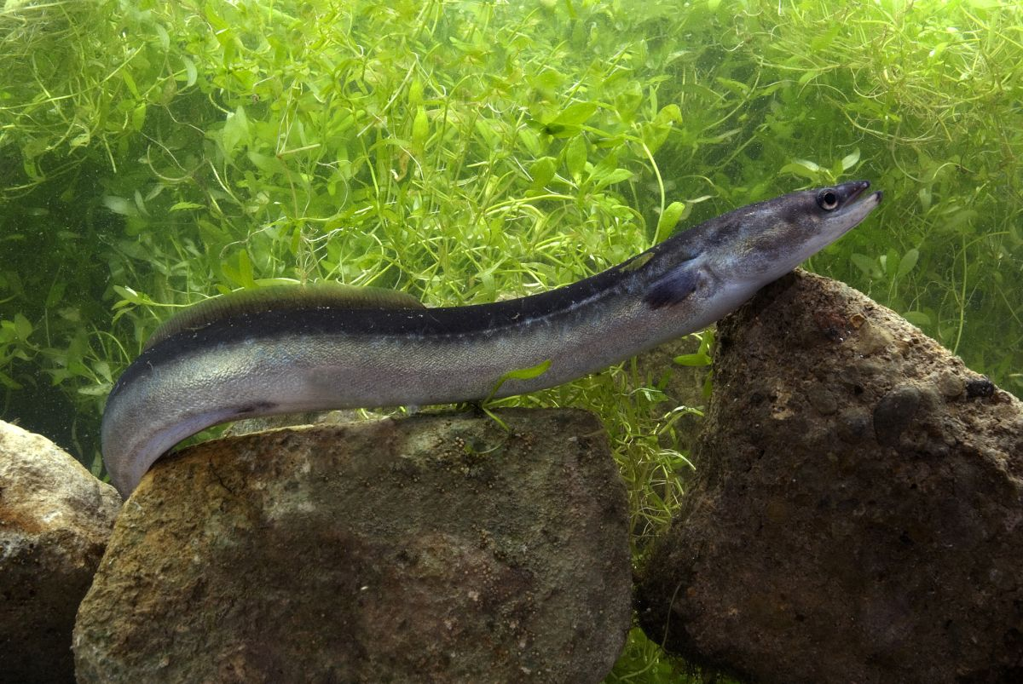
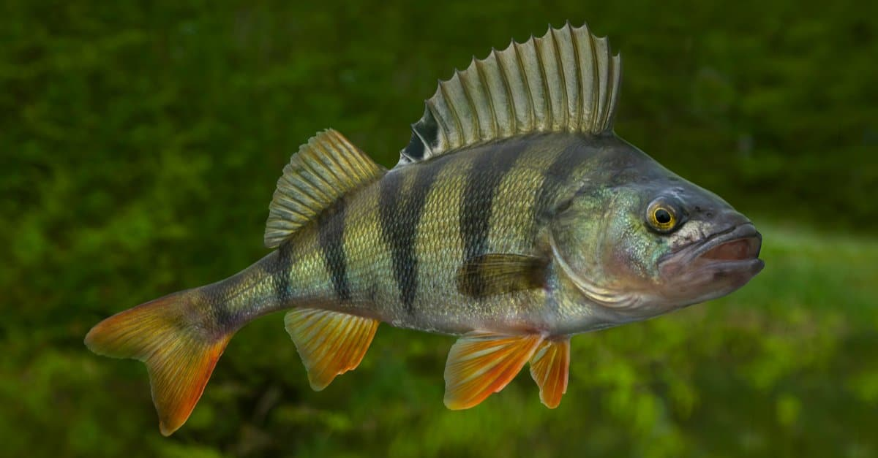
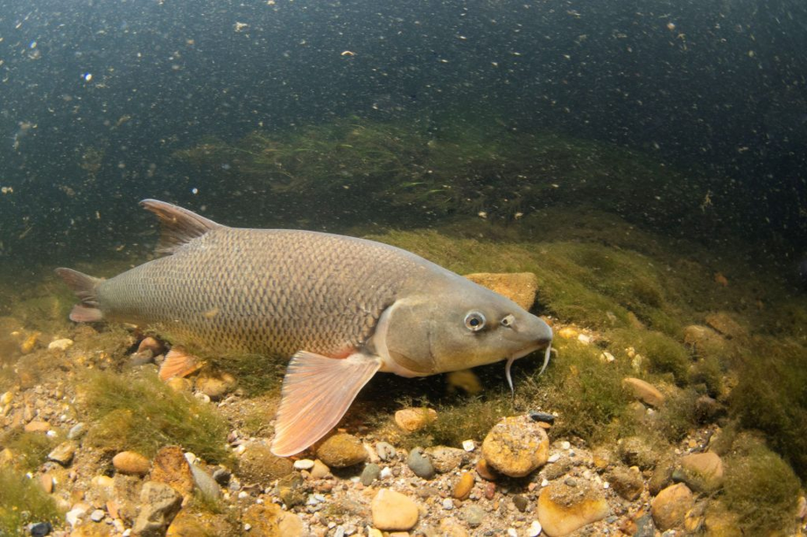
FISH
TAITH
AFON

Slide 16
FISH
TAITH
AFON
BROWN TROUT

Slide 17
FISH
TAITH
AFON
PIKE

Slide 18
FISH
TAITH
AFON
ATLANTIC SALMON

Slide 19
FISH
TAITH
AFON
EUROPEAN EEL

Slide 20
FISH
TAITH
AFON
PERCH

Slide 21
FISH
TAITH
AFON
BARBEL

Slide 22
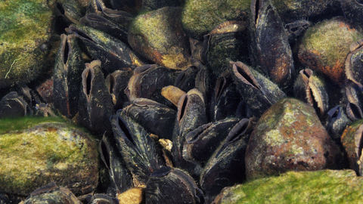
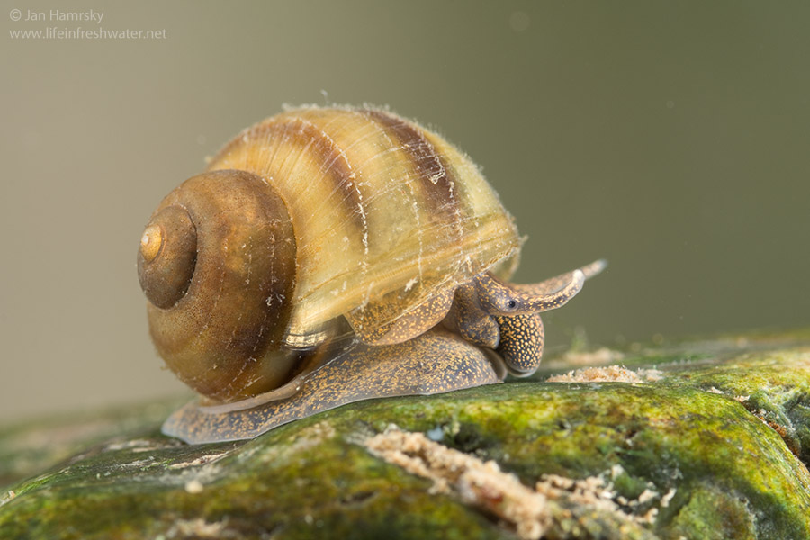
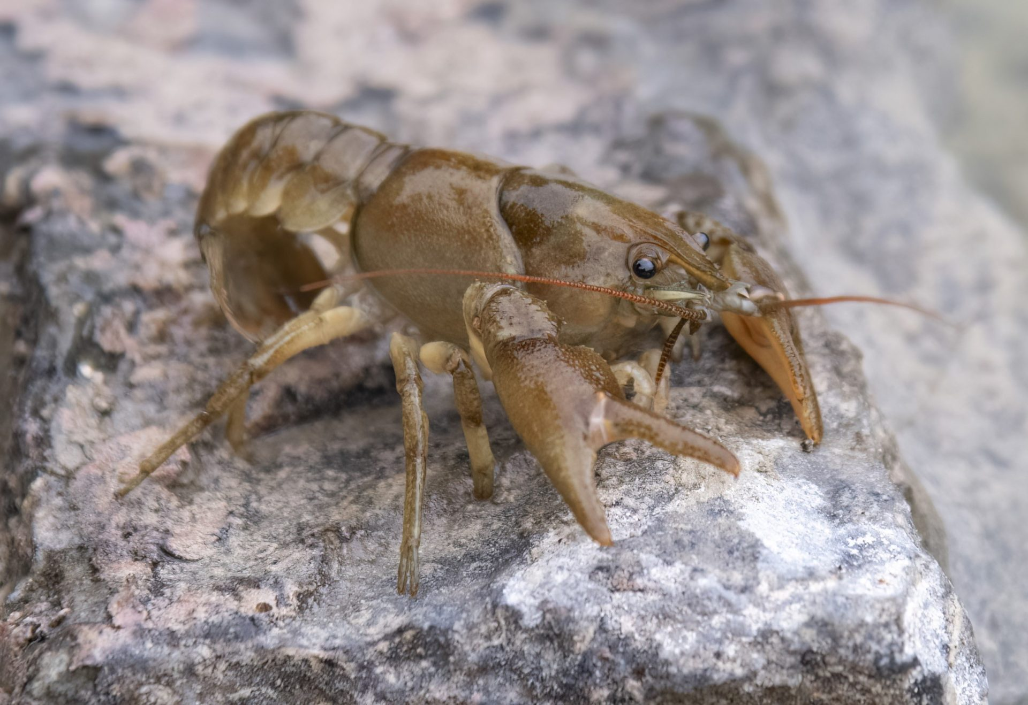
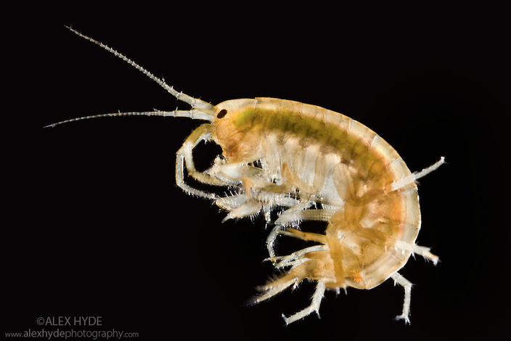
MOLLUSCS AND CRUSTACEANS
TAITH
AFON

Slide 23
MOLLUSCS AND CRUSTACEANS
TAITH
AFON
FRESHWATER PEARL MUSSELS

Slide 24
MOLLUSCS AND CRUSTACEANS
TAITH
AFON
FRESHWATER SNAIL

Slide 25
MOLLUSCS AND CRUSTACEANS
TAITH
AFON
WHITE CLAWED CRAYFISH

Slide 26
MOLLUSCS AND CRUSTACEANS
TAITH
AFON
FRESHWATER SHRIMP

Slide 27
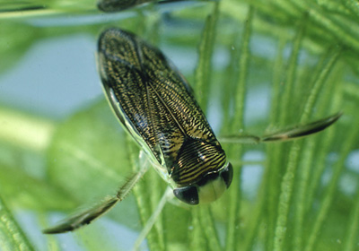
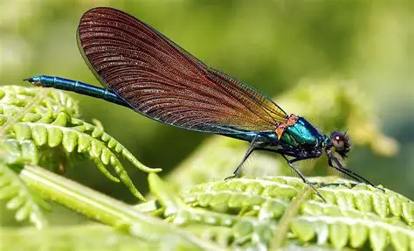
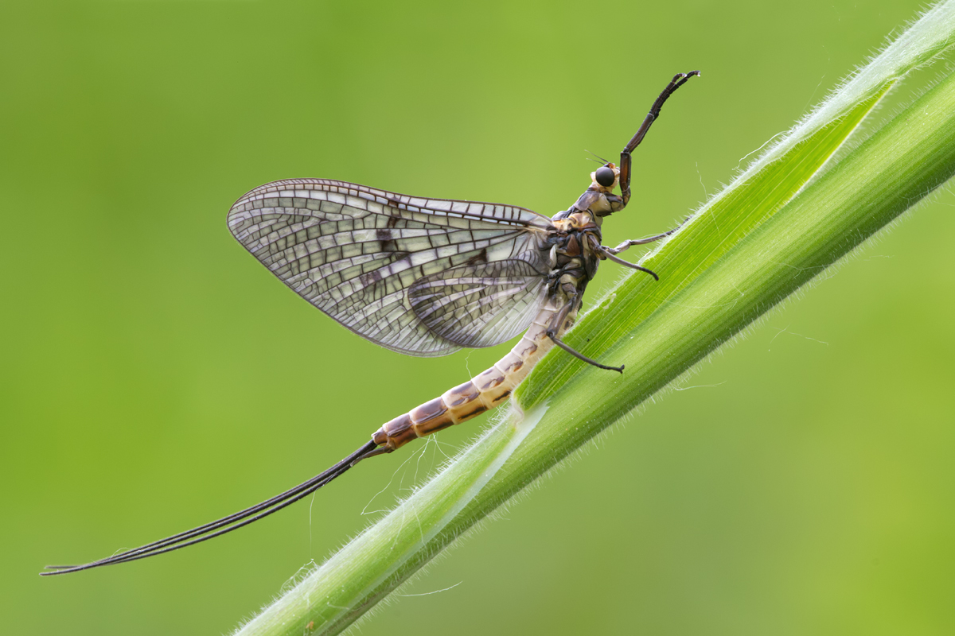
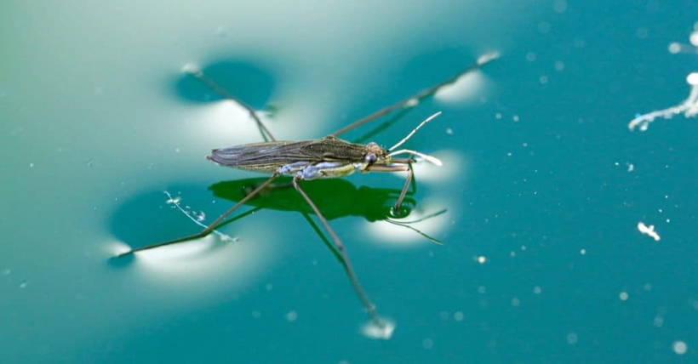
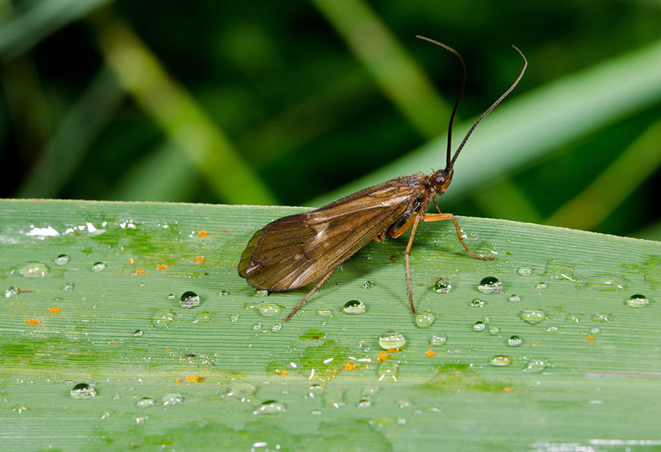
INVERTEBRATES
TAITH
AFON

Slide 28
INVERTEBRATES
TAITH
AFON
WATER BOATMAN

Slide 29
INVERTEBRATES
TAITH
AFON
DRAGONFLY

Slide 30
INVERTEBRATES
TAITH
AFON
MAYFLY

Slide 31
INVERTEBRATES
TAITH
AFON
POND SKATER

Slide 32
INVERTEBRATES
TAITH
AFON
CADDISFLY

Slide 33
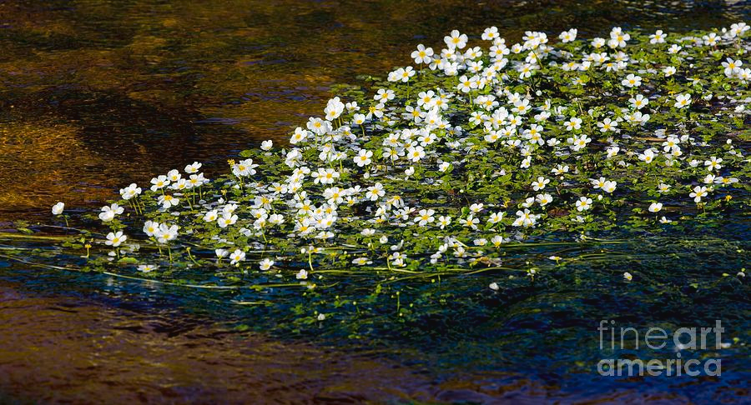
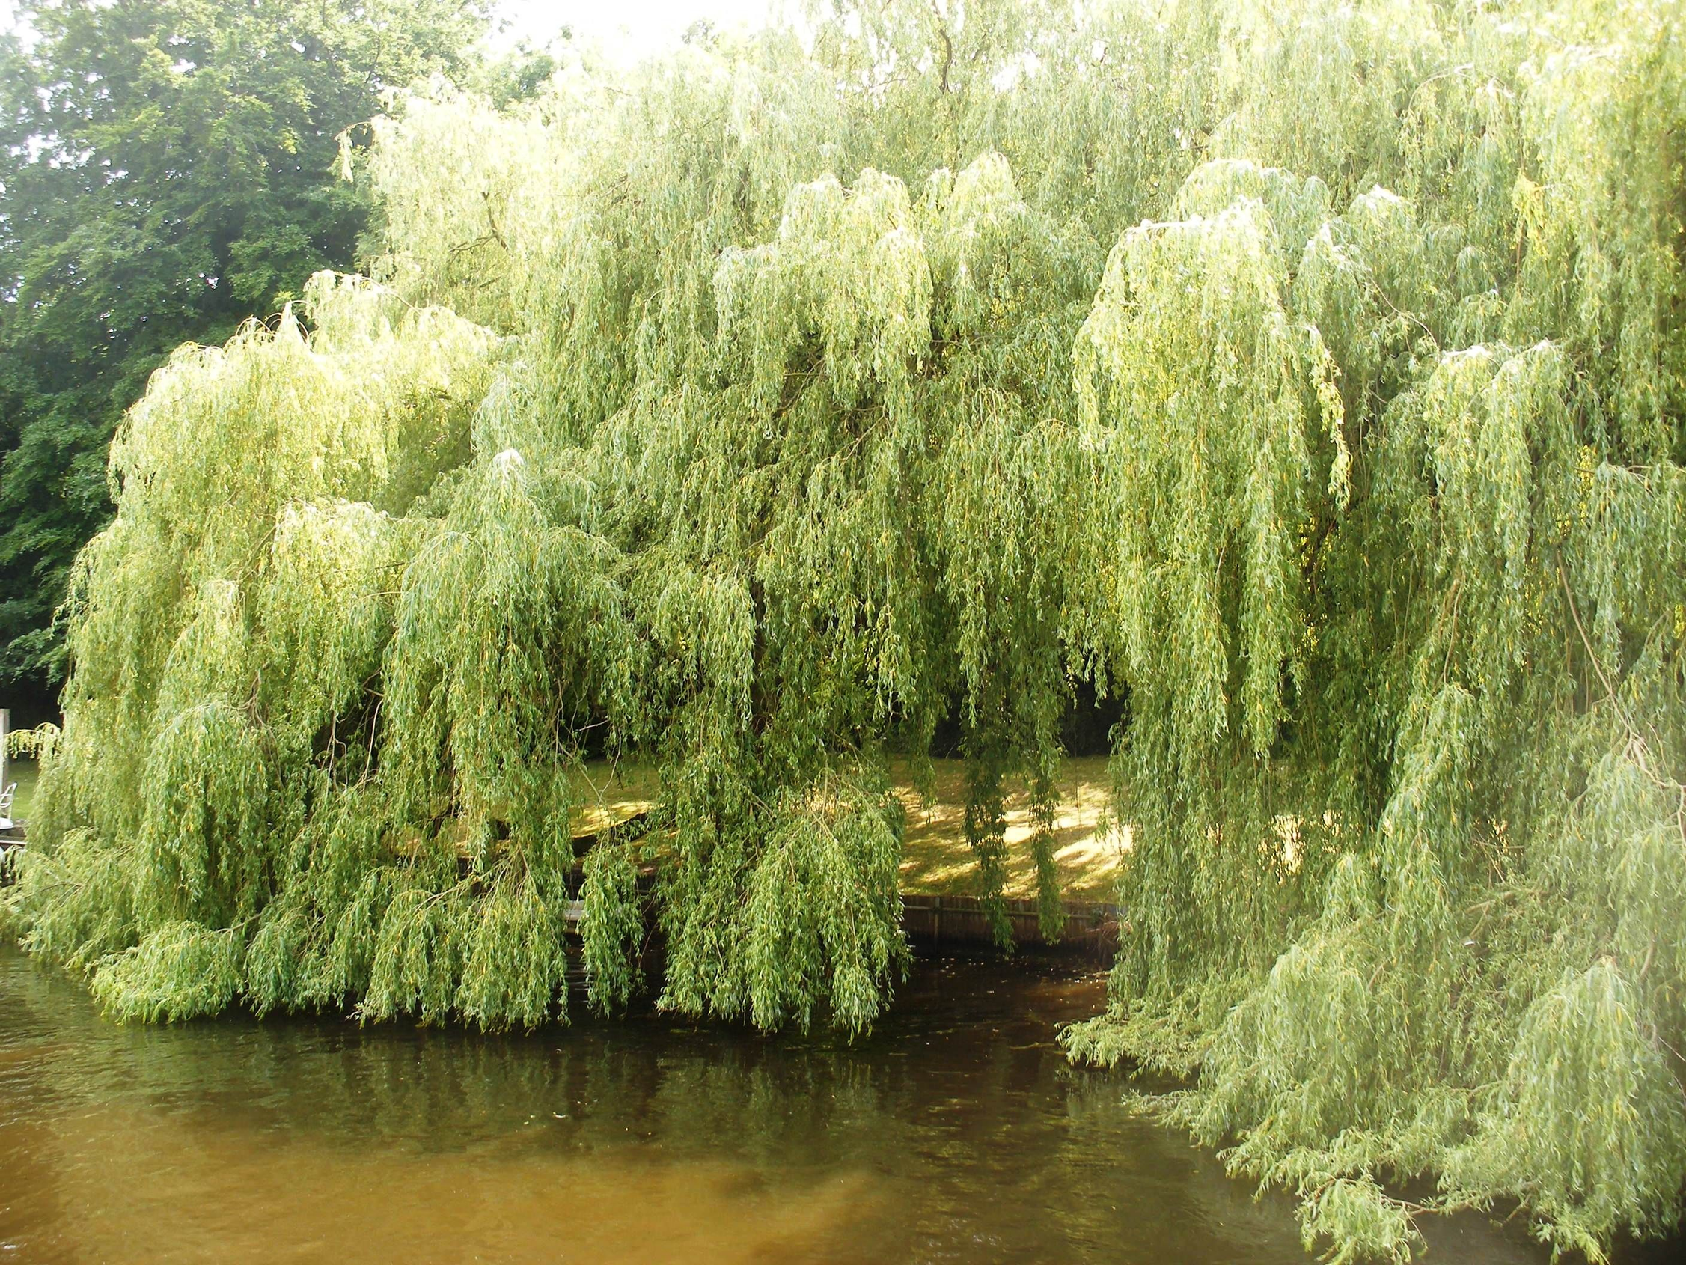
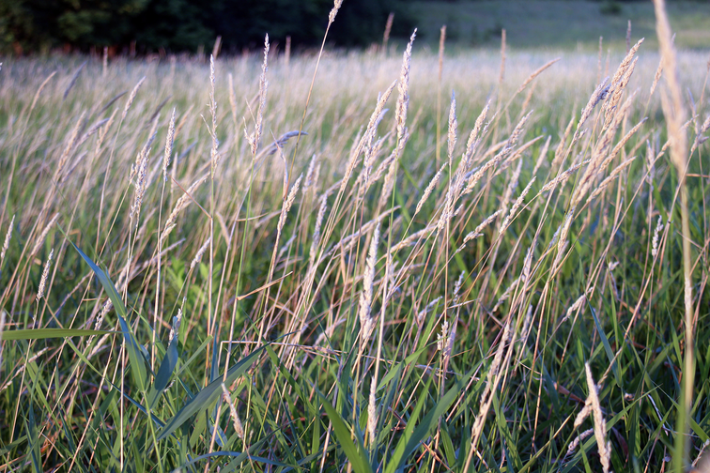
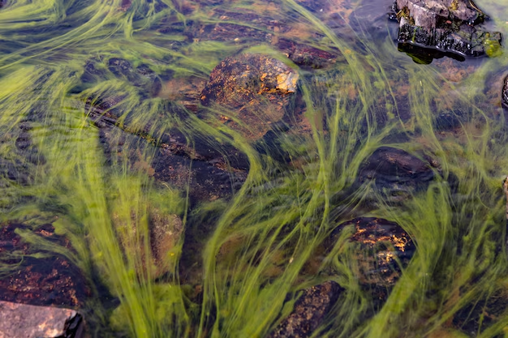
PLANTS
TAITH
AFON
WATER CROWFOOT

Slide 34
PLANTS
TAITH
AFON
WHITE WILLOW

Slide 35
PLANTS
TAITH
AFON

Slide 36
PLANTS
TAITH
AFON
COMMON REED

Slide 37
PLANTS
TAITH
AFON
ALGAE

Slide 38

LIFECYCLES
TAITH
AFON
SALMON
5-minute task

Slide 39

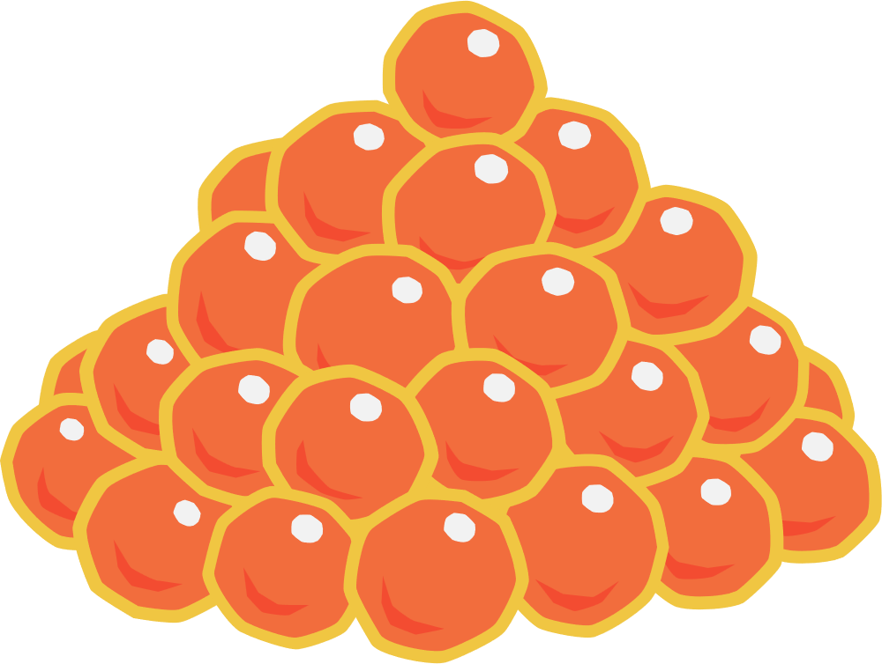

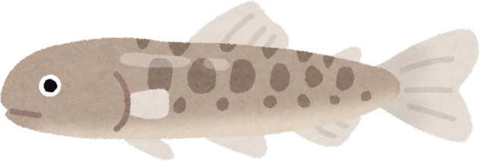
SALMON
TAITH
AFON
SPAWNING SALMON
ADULT SALMON
SALMON LIFE CYCLE
EGGS
SMOLT
ALEVIN
FRY

Slide 40
LIFECYCLES
TAITH
AFON
MAYFLY
5-minute task

Slide 41
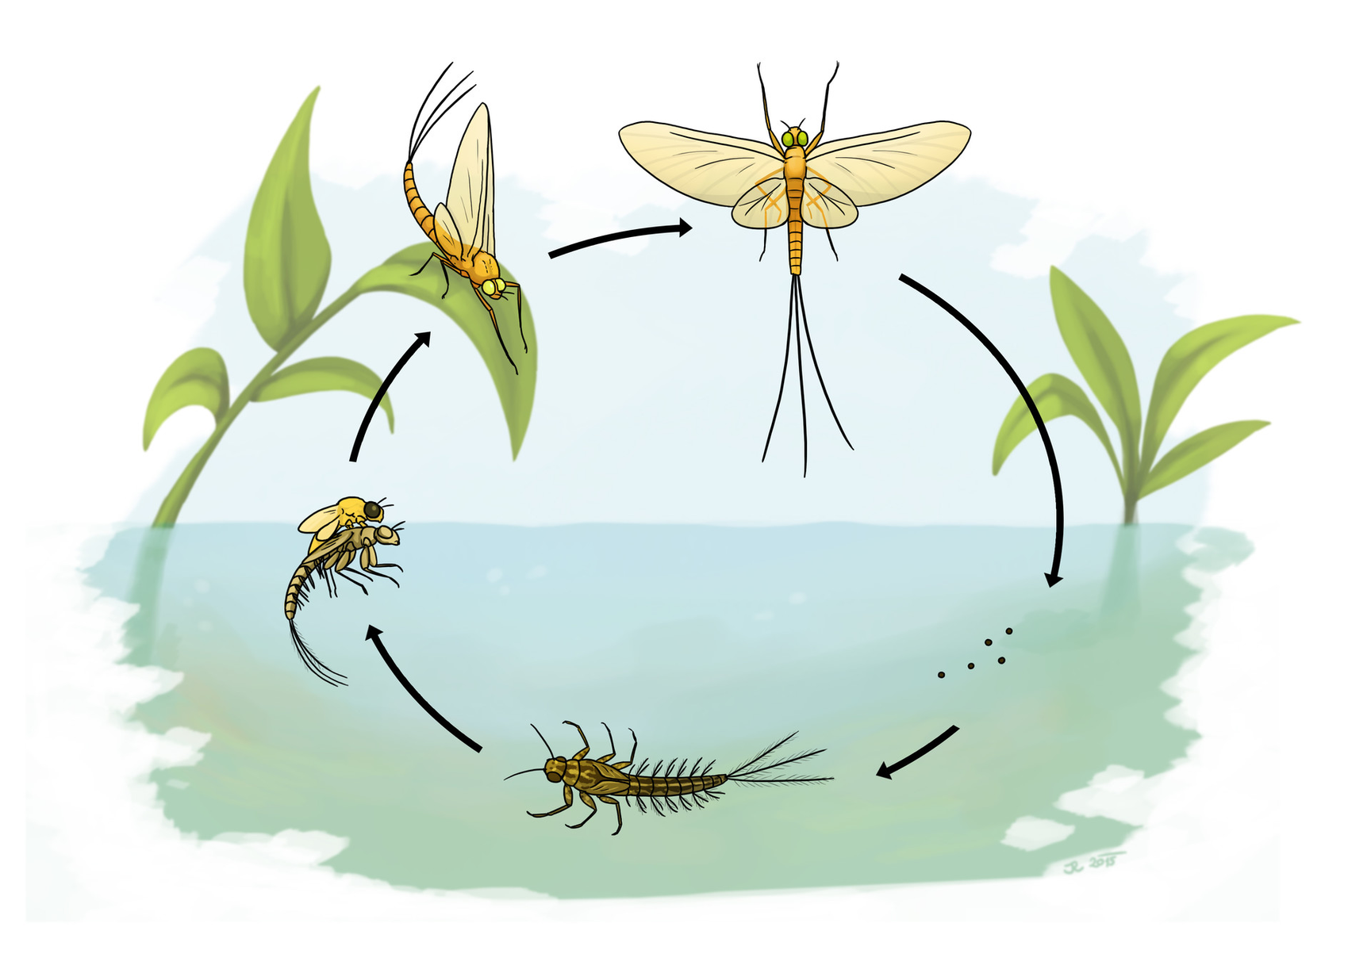
MAYFLY
TAITH
AFON
ADULT SPINNER
ADULT DUN
MAYFLY LIFE CYCLE
EMERGER
EGGS
NYMPH

Slide 42

FOOD CHAINS
TAITH
AFON
HOW MANY CAN YOU MAKE?
10-minute task

Slide 43

FOOD CHAIN EXAMPLE
TAITH
AFON

Slide 44

FOOD CHAIN EXAMPLE
TAITH
AFON
ARROWS SHOW THE MOVEMENT OF ENERGY, NOT WHO EATS WHO!

Slide 45

OUR RIVER ECOSYSTEM
TAITH
AFON

Slide 46
Stretch Activity
TAITH
AFON
Use the information around the room on the following topics to fill in your river research log.
Overfishing
Algal Overgrowth
Beaver Culling
Oil Spill
ARROWS SHOW THE MOVEMENT OF ENERGY, NOT WHO EATS WHO!

Slide 47
RIVER ECOSYSTEM –Print outs
Print the following slides, 1x per A4 and laminate to use in the next Activity.

