Slide 1


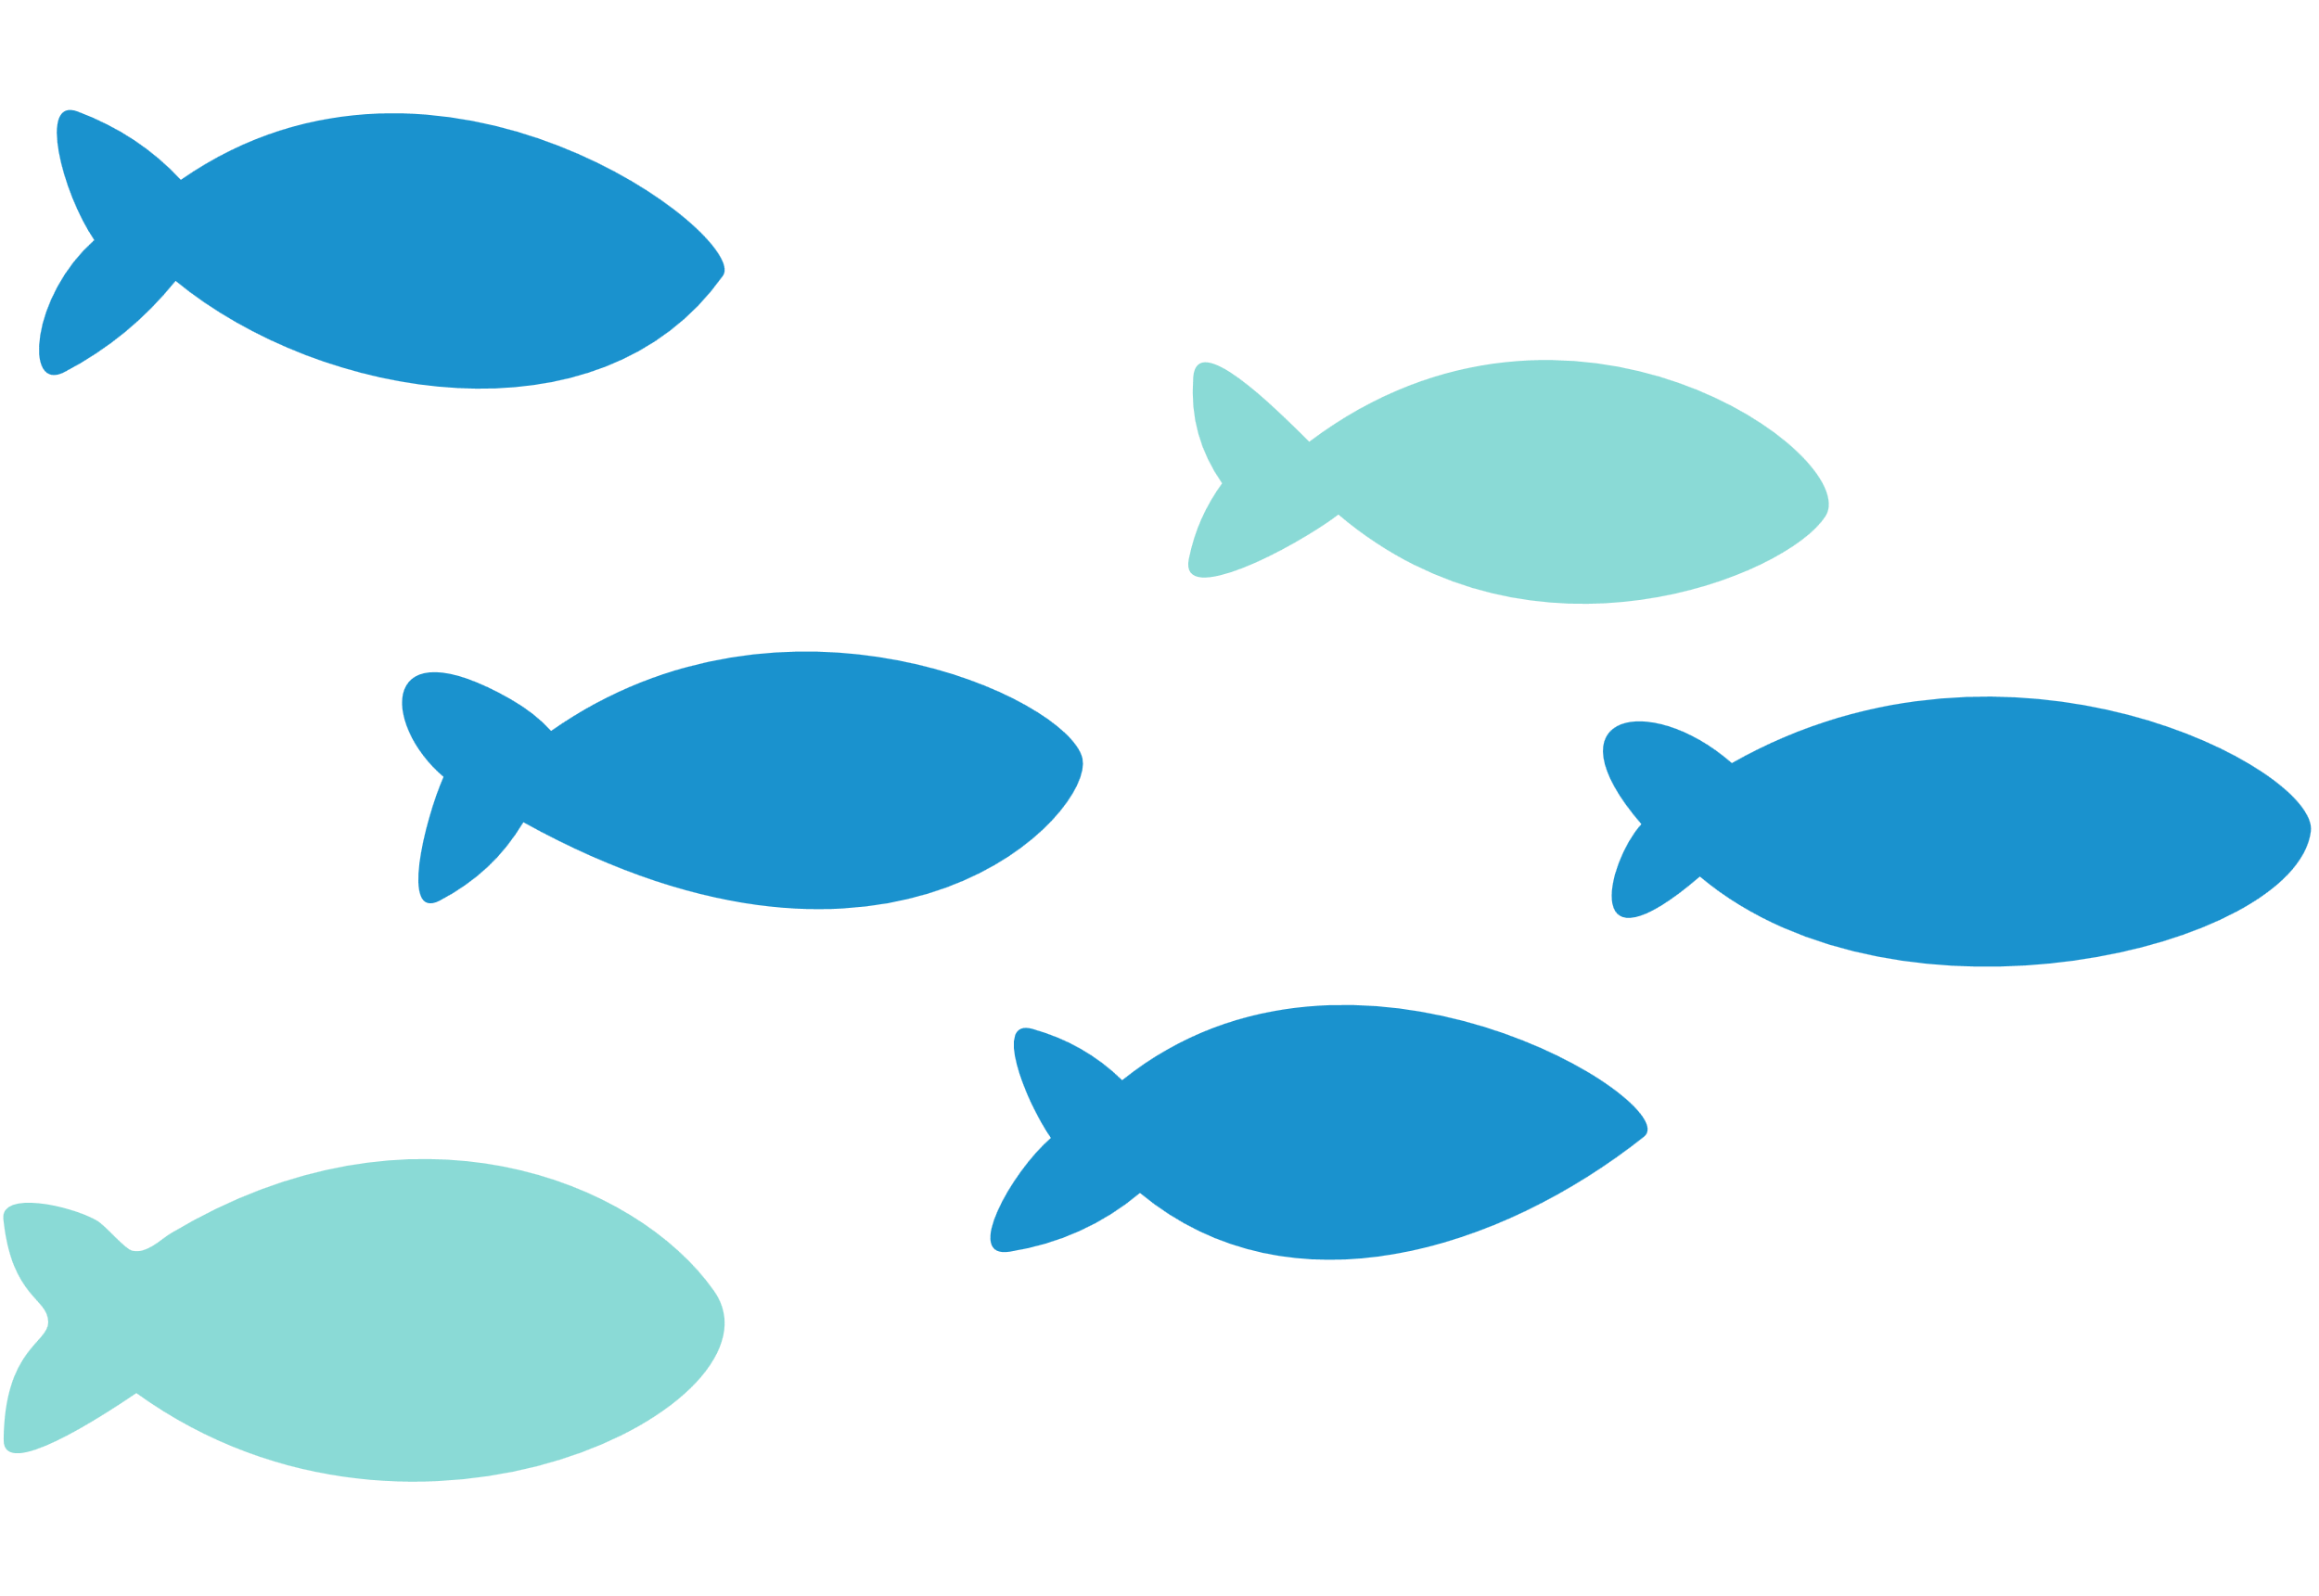
TAITH
AFON
RIVER CATCHMENTS
WORKSHOP SLIDES

Slide 2
TAITH
AFON
BY THE END OF THIS WORKSHOP, WE WILL...
Know what a river catchment is.
Understand what exists within our river catchment, and its potential impacts on our rivers.
Understand that to protect our rivers, we must include every aspect within the river catchment.

Slide 3


What is a river catchment ?
TAITH
AFON
Your river

Slide 4
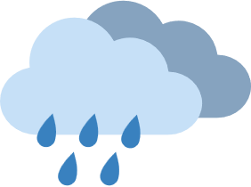
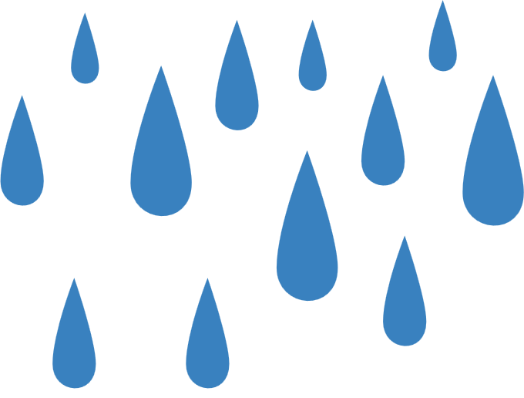


What is a river catchment ?
TAITH
AFON
Your river catchment

Slide 5
What is a river catchment ?
TAITH
AFON
Not in your catchment!

Slide 6
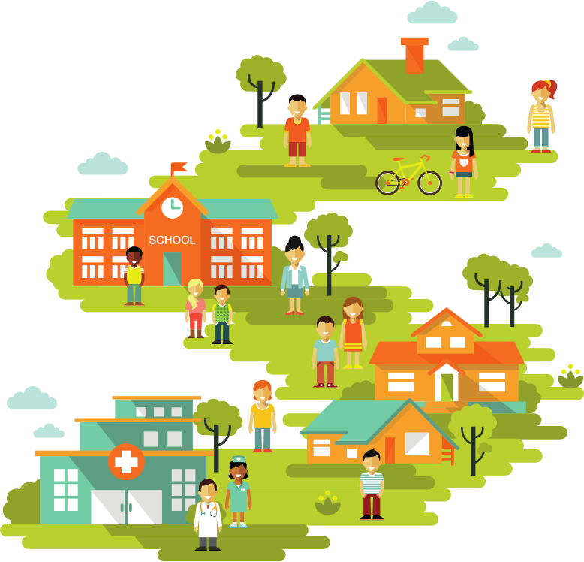
Whats in our river catchment ?
TAITH
AFON
Our homes, schools, doctors and shops making up our towns and cities

Slide 7


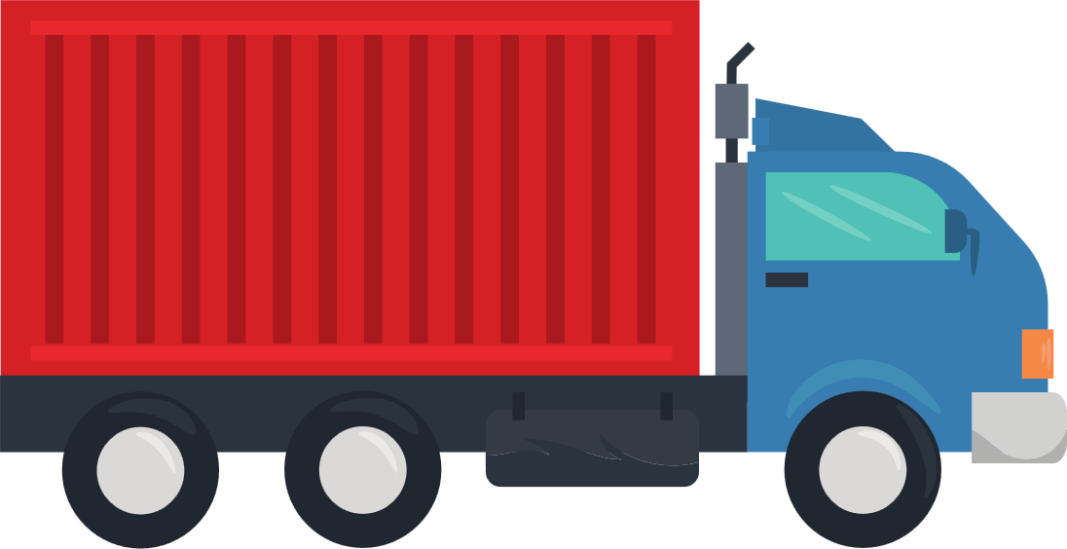

Whats in our river catchment ?
TAITH
AFON
Our roads, bridges and vehicles

Slide 8
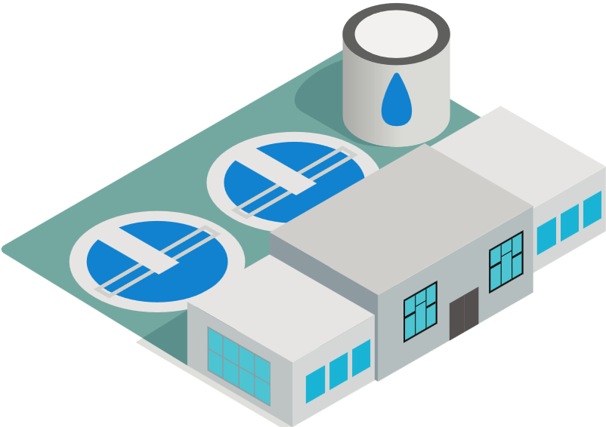
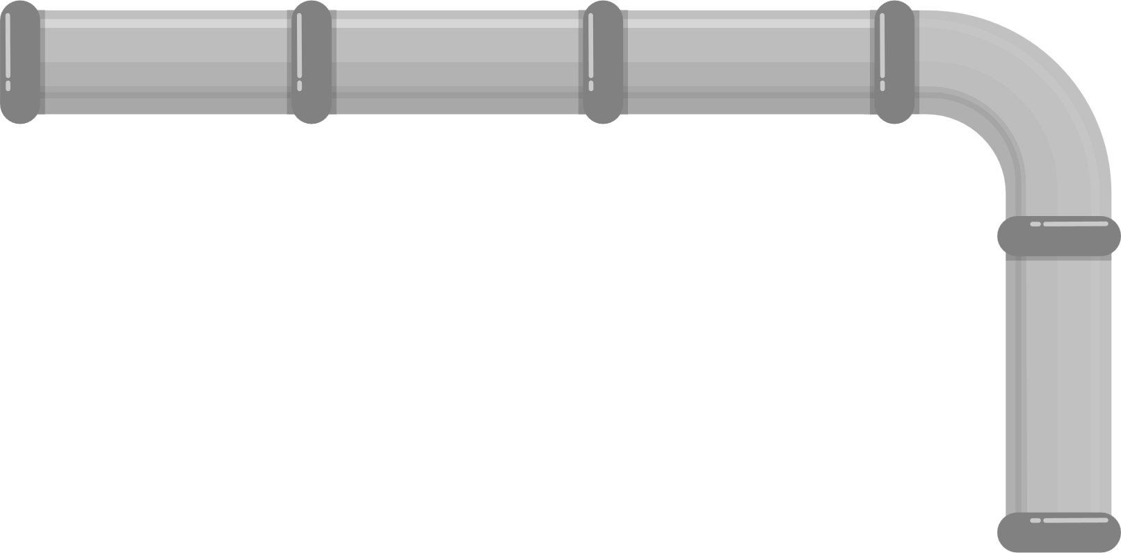
Whats in our river catchment ?
TAITH
AFON
Water treatment works to take our waste and give us clean water

Slide 9
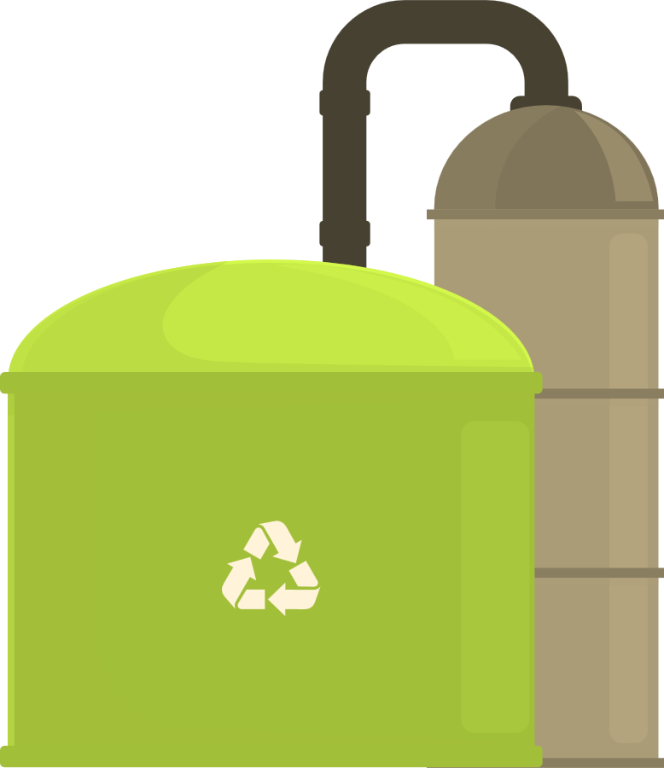
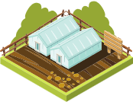
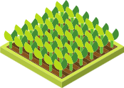
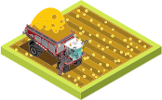
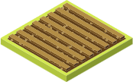
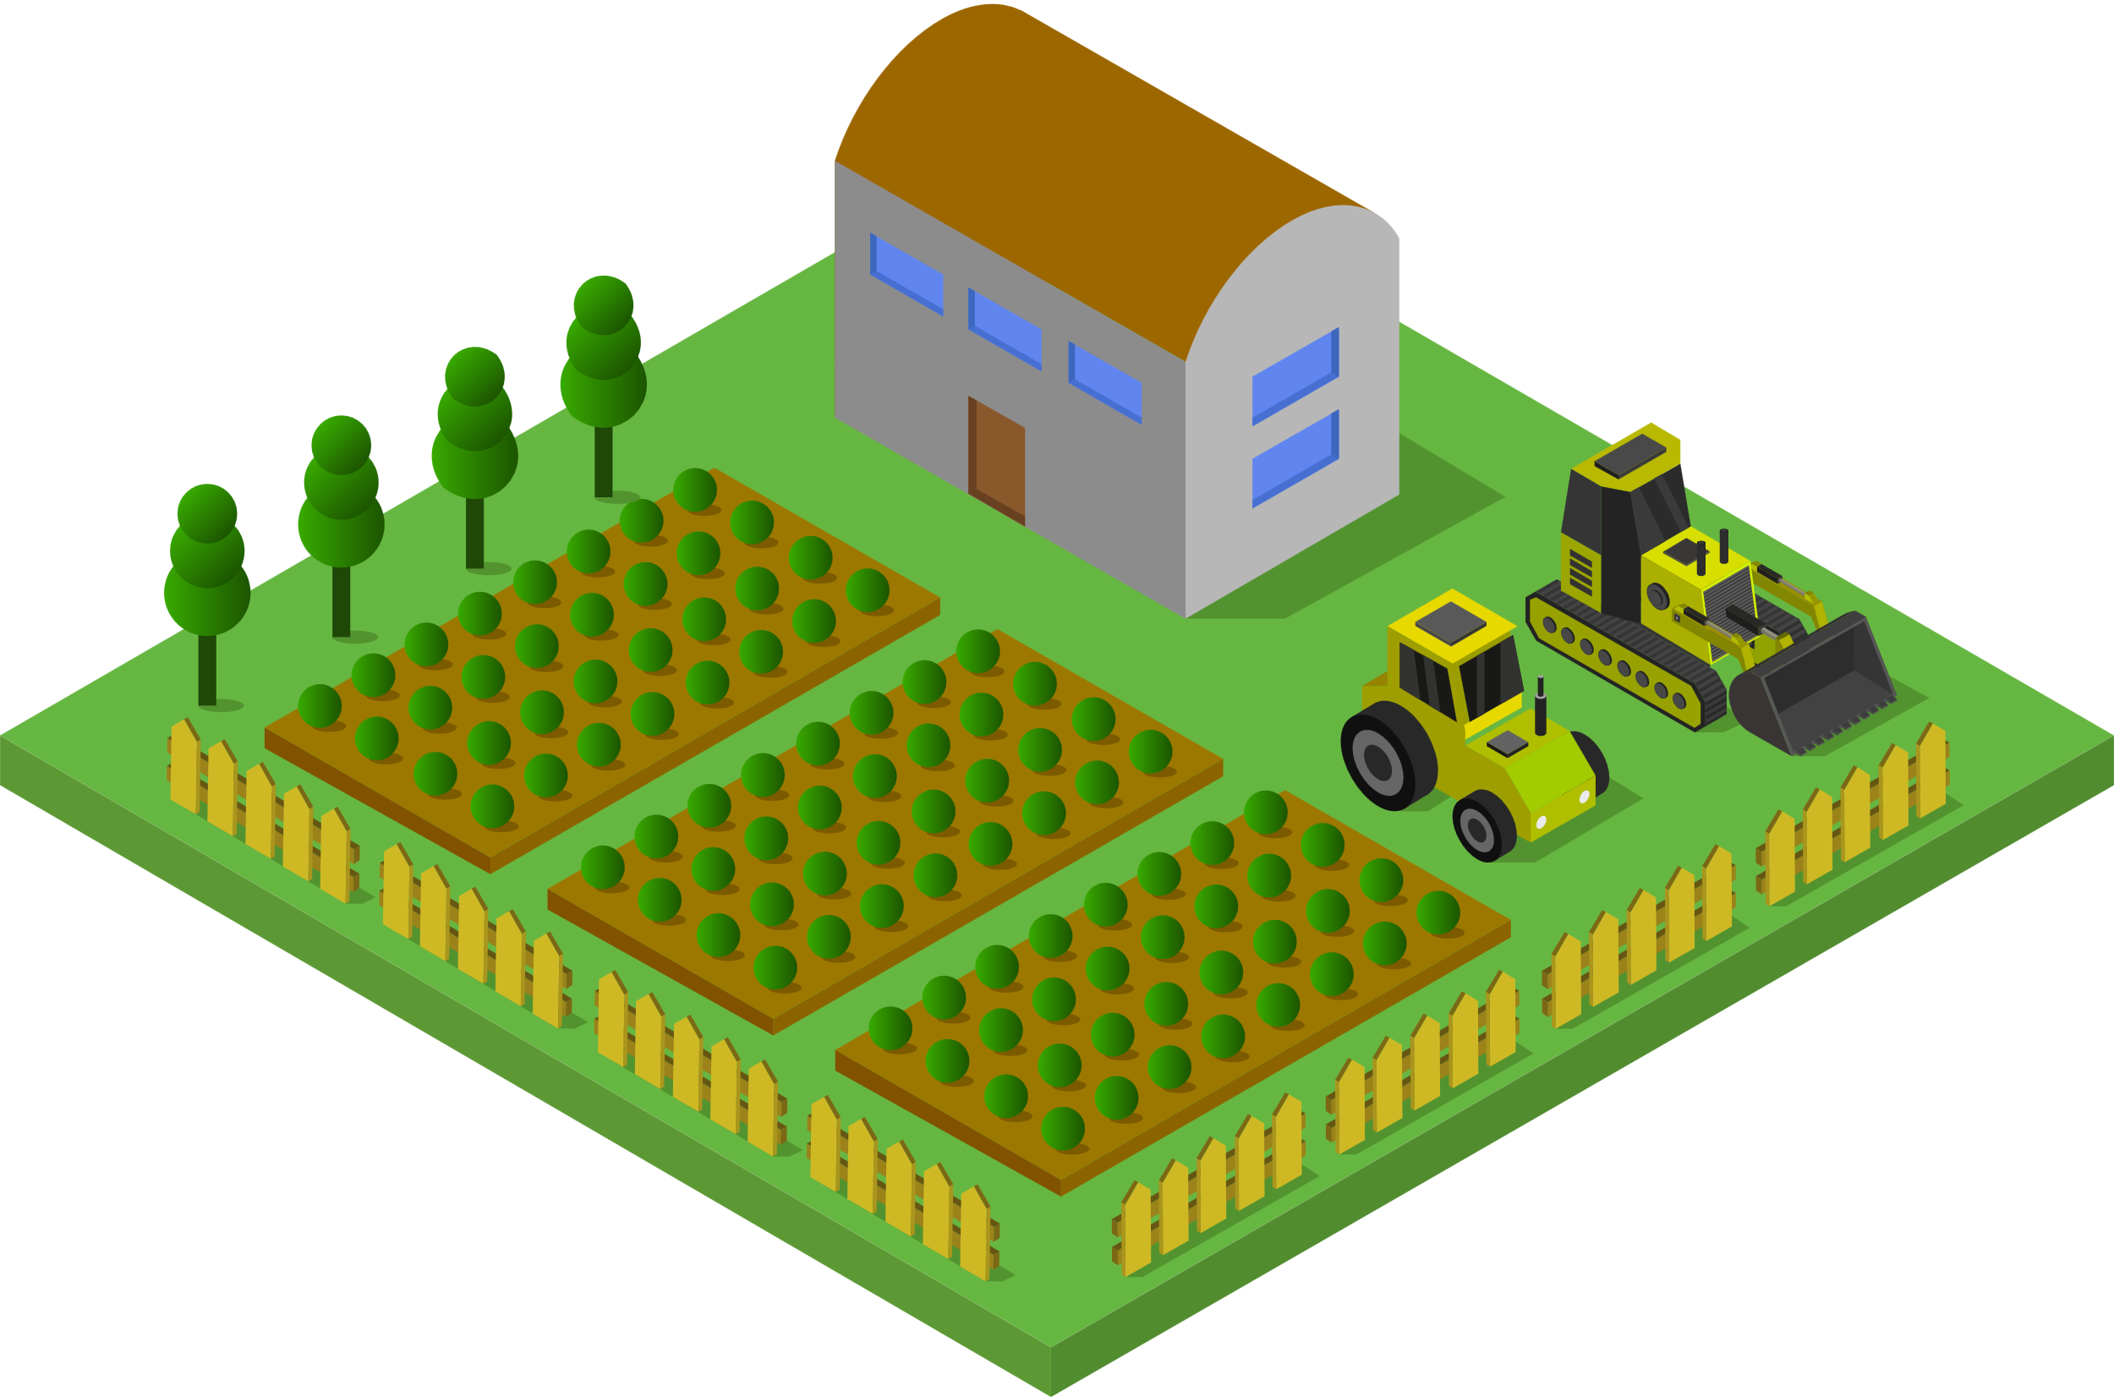
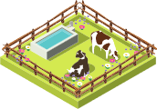
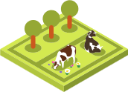
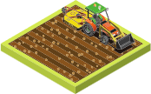
Whats in our river catchment ?
TAITH
AFON
Agriculture to grow our food

Slide 10

Whats in our river catchment ?
TAITH
AFON
Industry to make us things

Slide 11
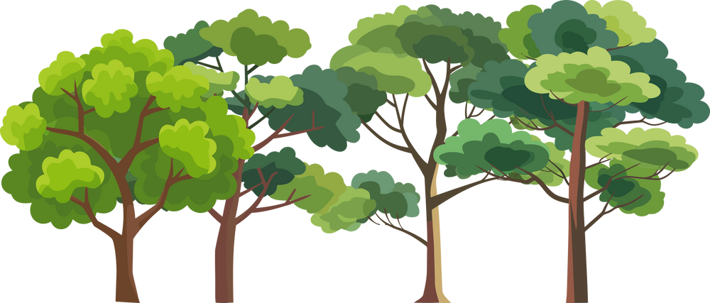
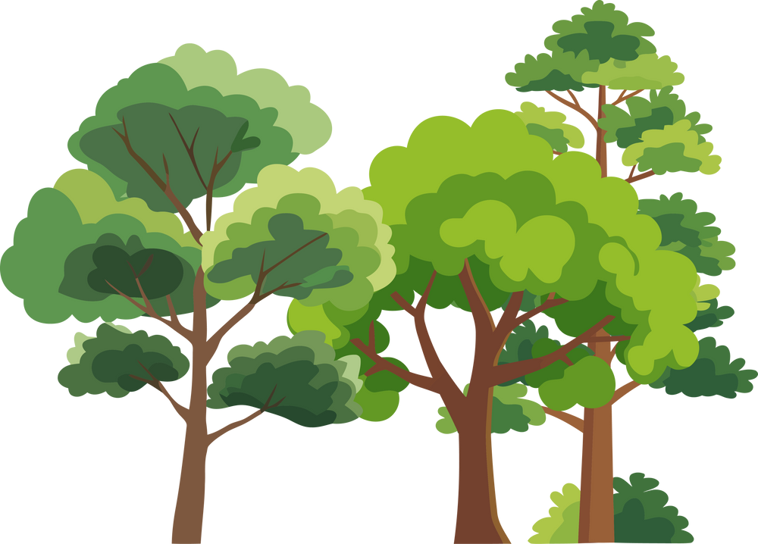
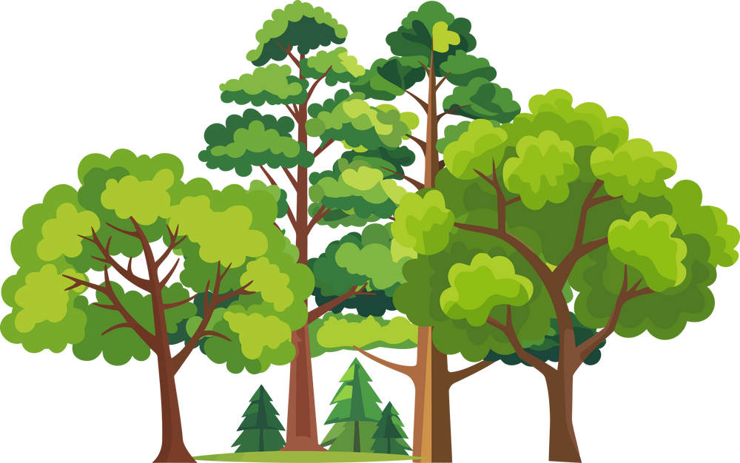
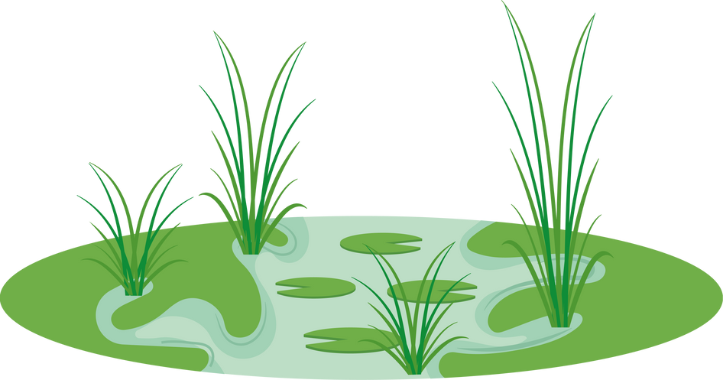
Whats in our river catchment ?
TAITH
AFON
All alongside nature that brings us enjoyment, and keeps our environment healthy

Slide 12
So, what happens when it rains?
TAITH
AFON

Slide 13
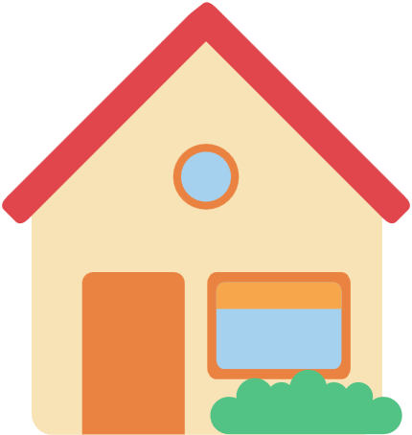




Rural Areas
TAITH
AFON
On our homes we get runoff:
Runoff from our driveways
Runnoff from roofs
Runoff from the street
This picks up any waste, leaves, oil, and detergents

Slide 14
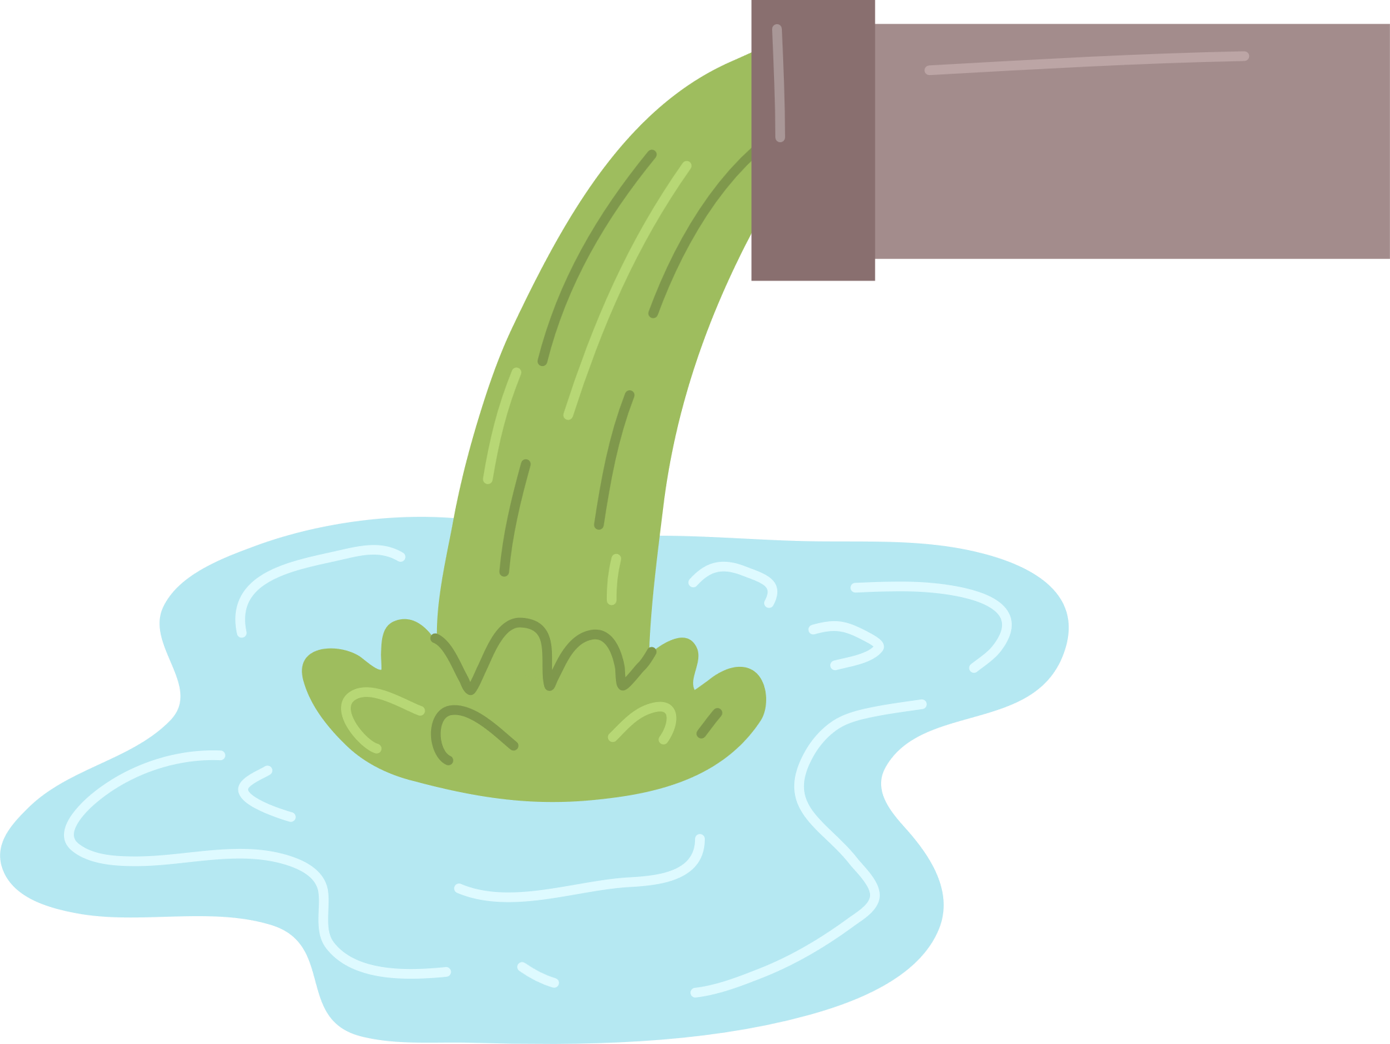
Water Treatment Works
TAITH
AFON
Sometimes our water treatment works can’t cope with the amount of rain. This causes them to overflow sewage into our rivers.

Slide 15
Agriculture
TAITH
AFON
Fields with exposed soils and fertilisers can runnoff into our rivers.
Dirty farmyards, poorly managed slurry storage and livestock can also cause increased nutrients in our rivers.

Slide 16

Industry
TAITH
AFON
Often, waste from factories and other industry can be disposed of incorrectly resulting it to end up in our rivers.

Slide 17

Nature
TAITH
AFON
Trees and wetlands absorb the excess nutrients produced by human practices.

Slide 18





We have to look at the whole catchment to protect our rivers
TAITH
AFON

Slide 19

TAITH
AFON
RIVER CATCHMENTS
ACTIVITY

Slide 20
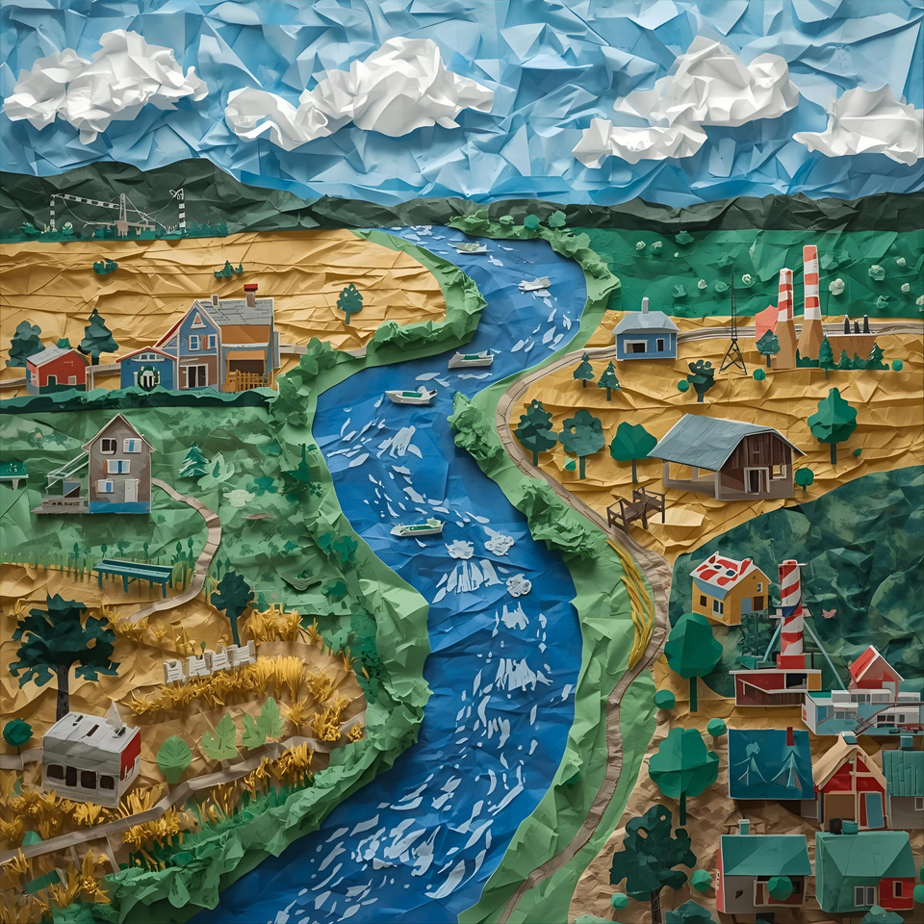
BRING YOUR RIVER CATCHMENT TO LIFE
TAITH
AFON
Use a range of materials to create your local river and elements within your catchment. Think about where you live and what surrounds your local river.
Keep your map simple using the following categories:
Agriculture
Industry
Urban Areas
Nature

Slide 21
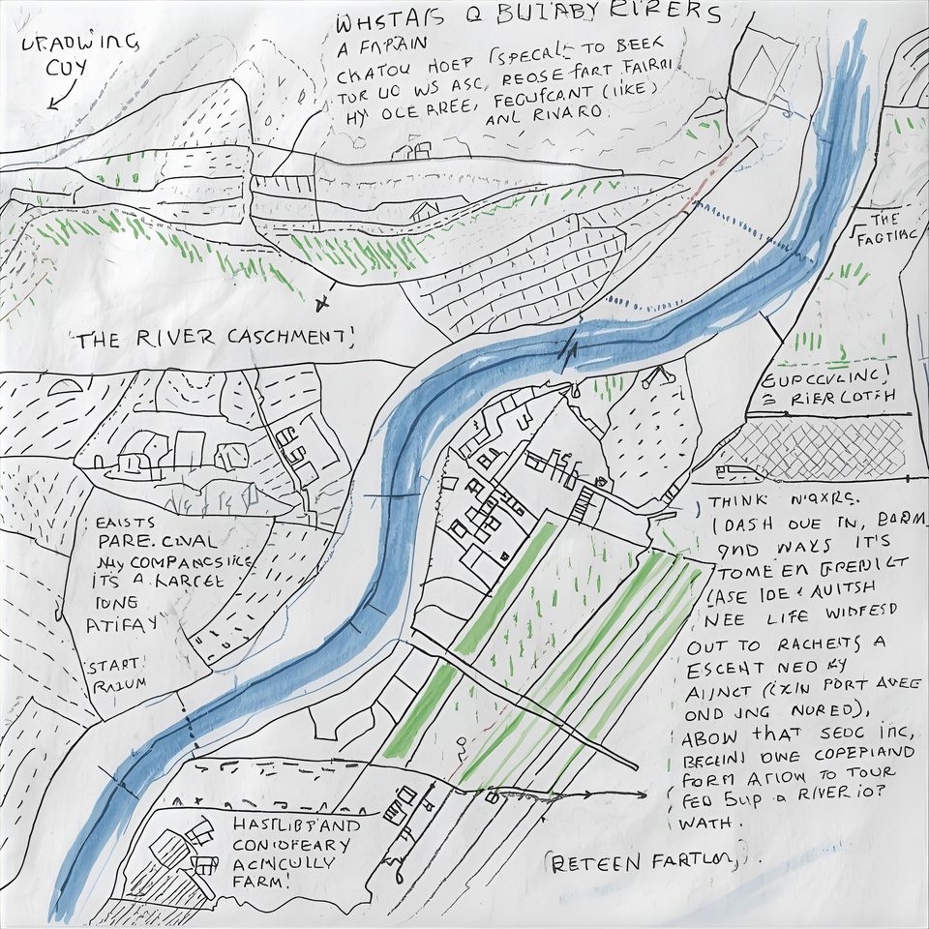
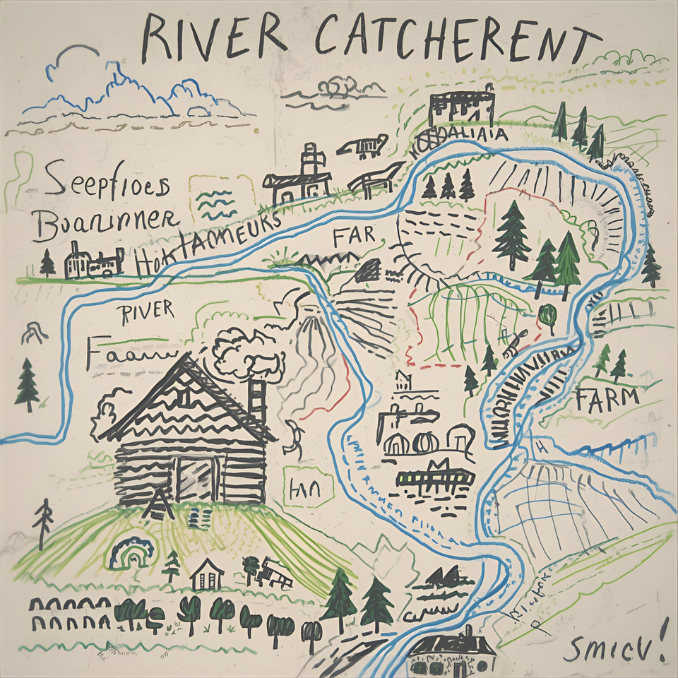
VISIT YOUR LOCAL RIVER
TAITH
AFON
We will be visiting our local river. While we explore take notes of your surroundings as we will then be drawing our river catchment map!
Keep your map simple using the following categories:
Agriculture
Industry
Urban Areas
Nature

Slide 22
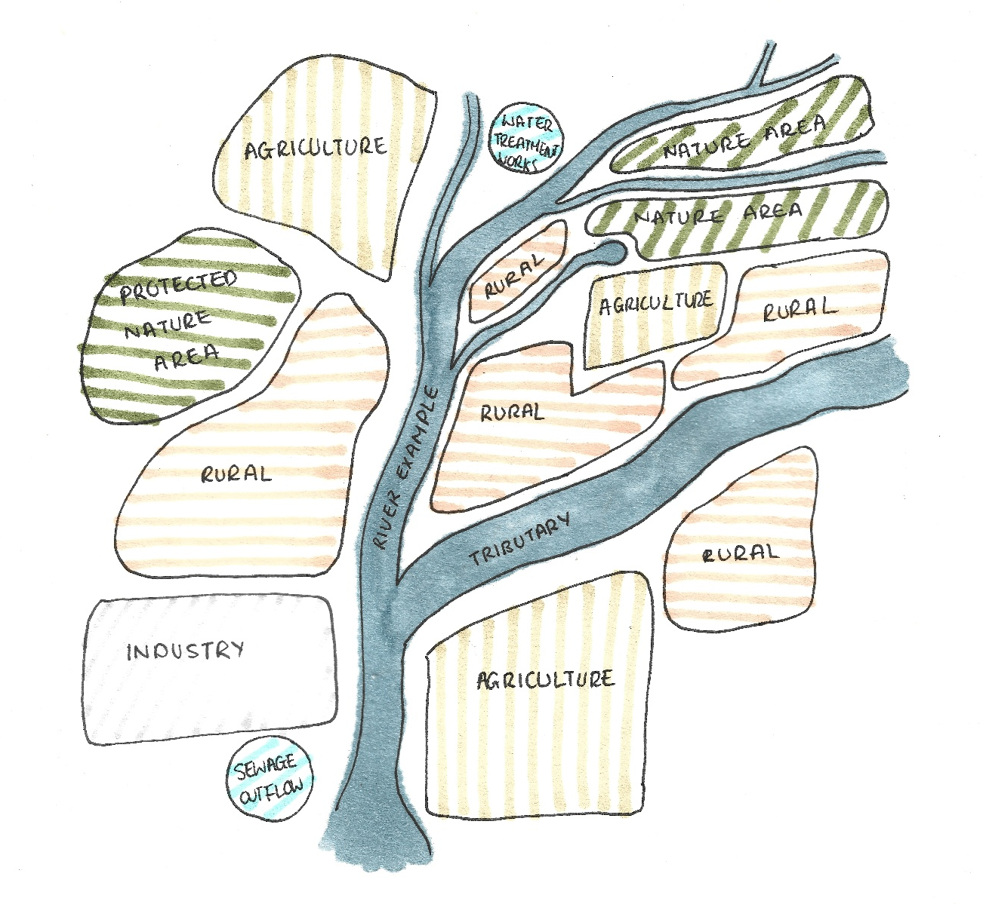
MAP YOUR LOCAL RIVER
TAITH
AFON
Agriculture Land Use:
Data Map Wales - Agricultural land classification: predictive map https://datamap.gov.wales/maps/new?layer=inspire-wg:wg_predictivealc
Flood Risk Areas:
Flood and Coastal Erosion Risk Maps - https://flood-risk-maps.naturalresources.wales/?locale=en
Water Treatment Works:
Storm Overflow Map - https://corporate.dwrcymru.com/en/community/environment/storm-overflow-map
MAGIC Map: Land Designations Interactive Map - https://magic.defra.gov.uk/
Search layers:
Wales (click all that apply)
Special Protection Areas
Special Areas of Conservation
Sites of Scientific Interest
These are all environmentally important areas to consider in your catchment.

Slide 23
DISCUSSION
TAITH
AFON
What elements are in your local river catchment?
How might these affect our river?

Slide 24
TAITH
AFON
BY THE END OF THIS WORKSHOP, WE WILL...
Know what a river catchment is.
Understand what exists within our river catchment, and its potential impacts on our rivers.
Understand that to protect our rivers, we must include every aspect within the river catchment.

