Slide 1


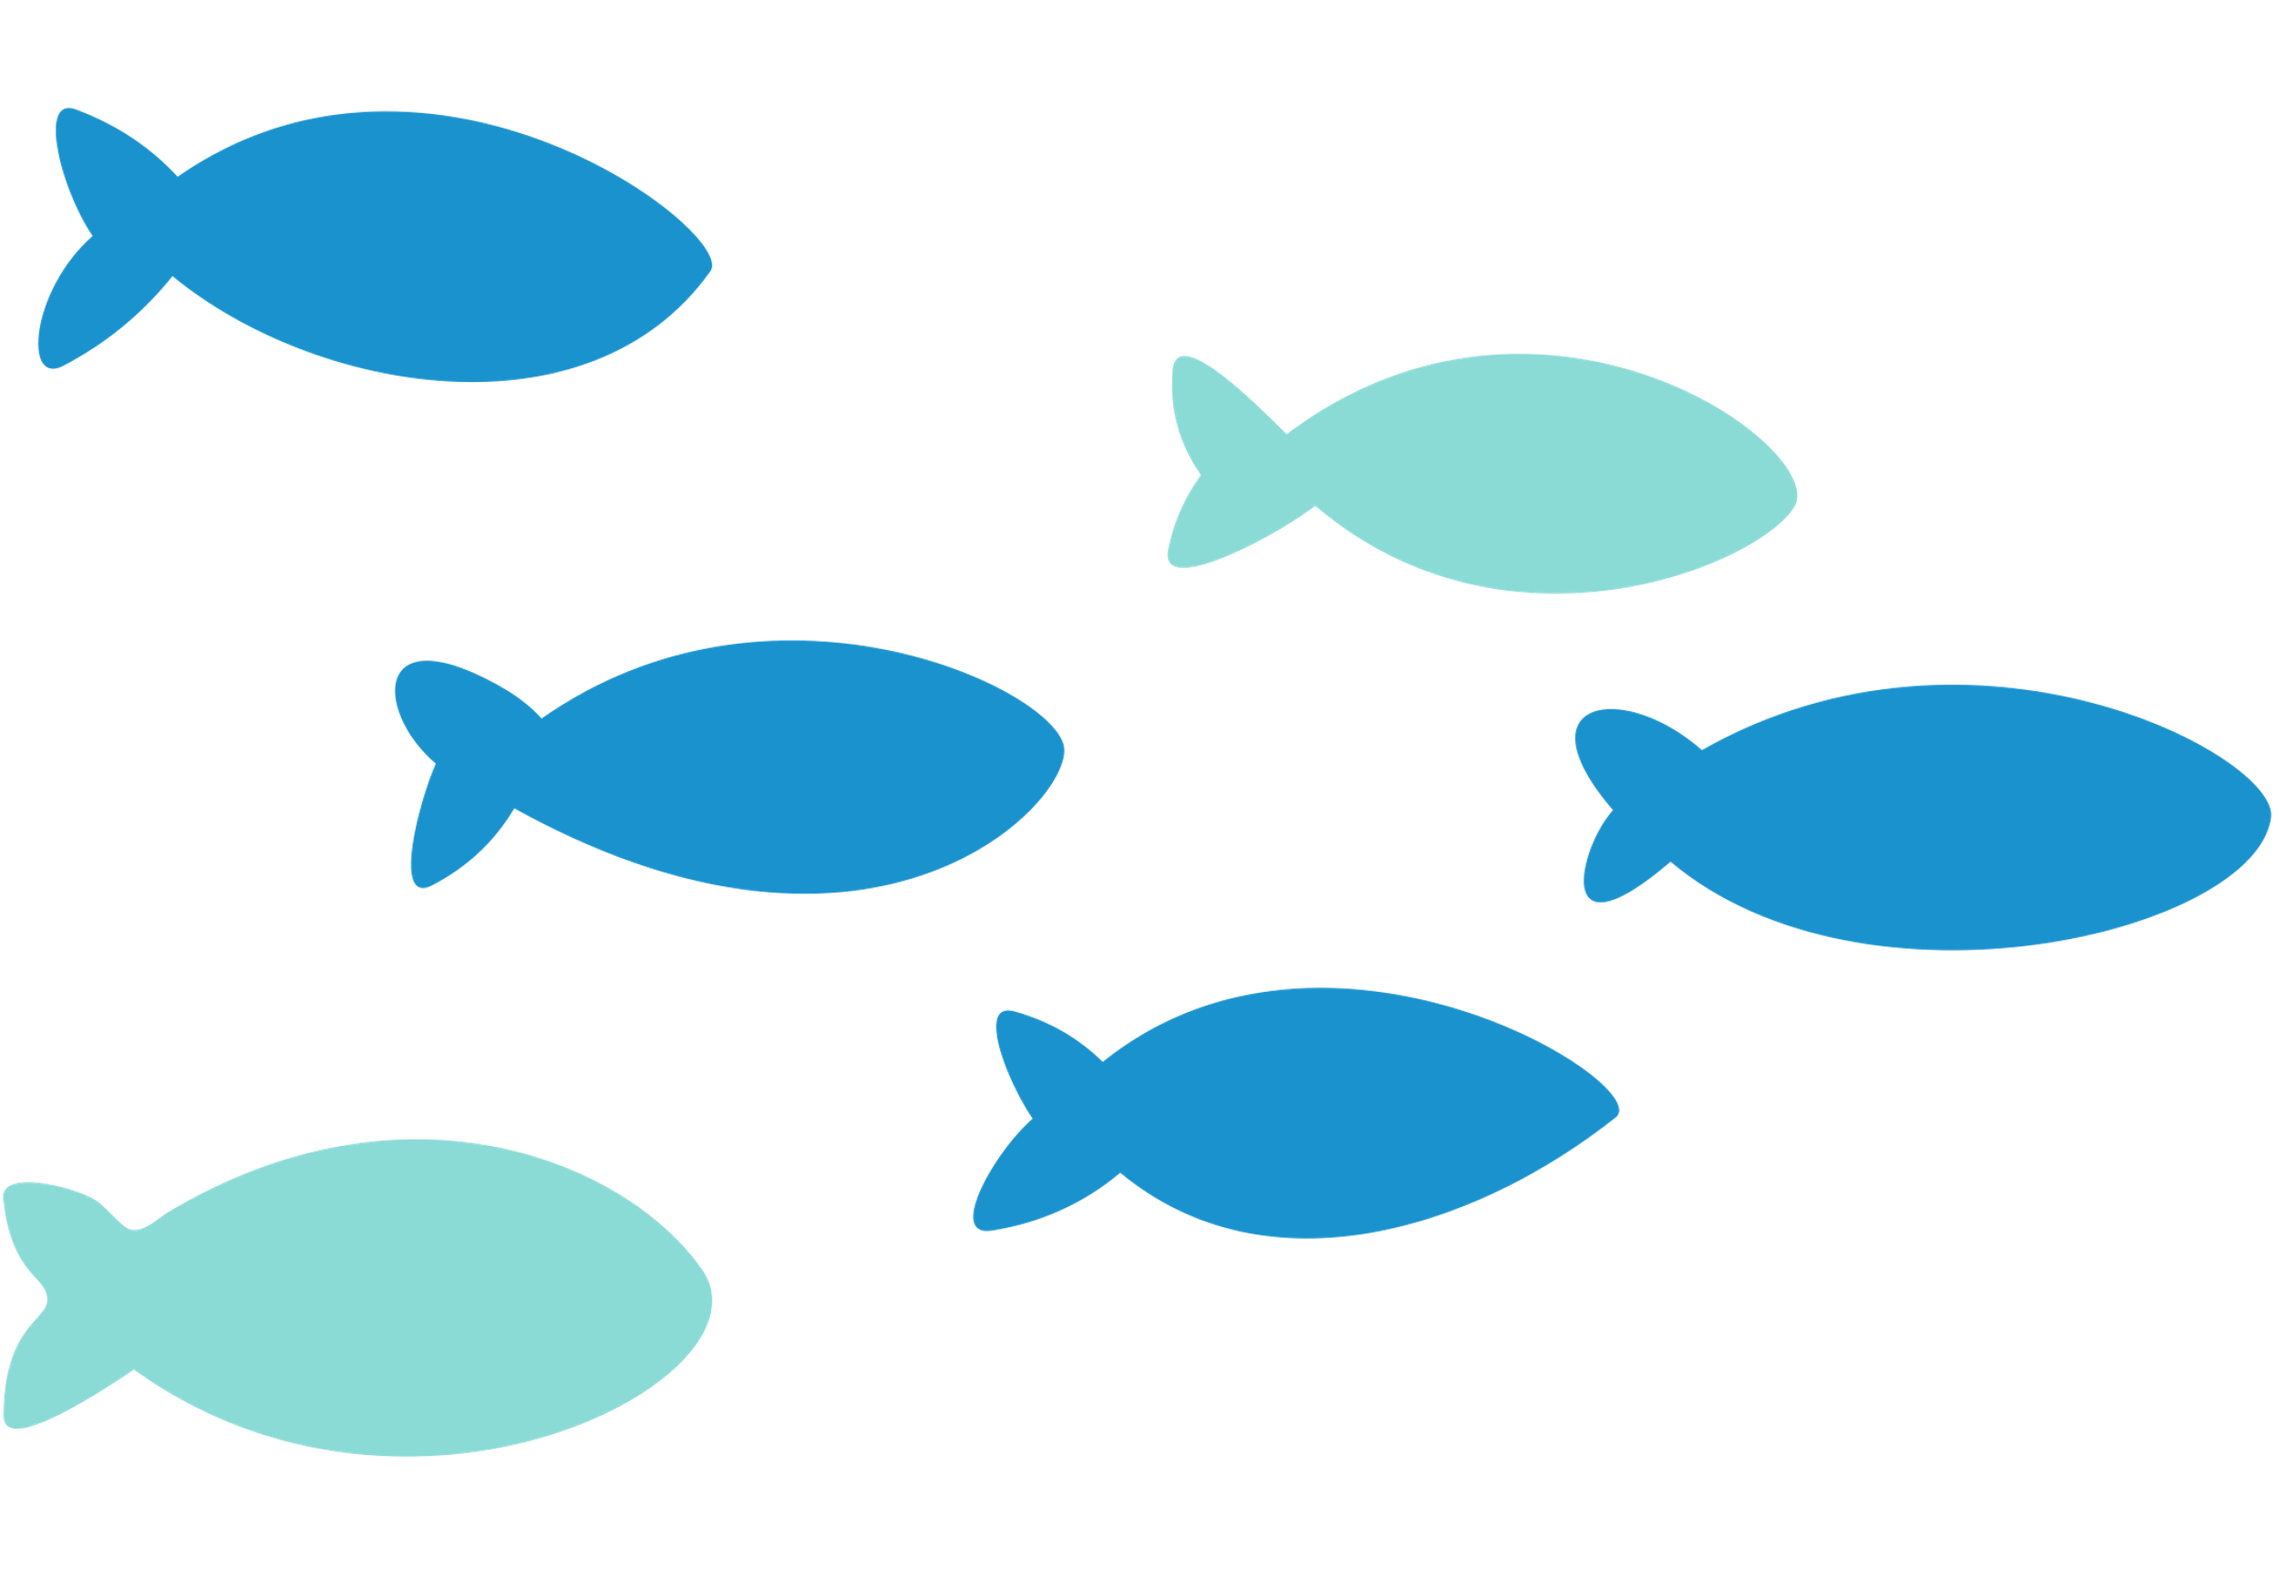
TAITH
AFON
RIVER HEALTH
WORKSHOP SLIDES

Slide 2
TAITH
AFON
IECHYD AFON
DEFNYDD GWEITHDY

Slide 3
TAITH
AFON
BY THE END OF THIS WORKSHOP, WE WILL...
Be able to visually identify types of water pollution
Understand where different pollutions come from
Identify prevention methods to protect a rivers’ health

Slide 4
TAITH
AFON
ERBYN DIWEDD Y GWEITHDY, BYDDWN YN...
Gallu adnabod mathau o lygredd dwr
Deall ble mae gwahanol lygredd yn dod o
Adnabod dulliau atal er mwyn amddiffyn iechyd afon.

Slide 5
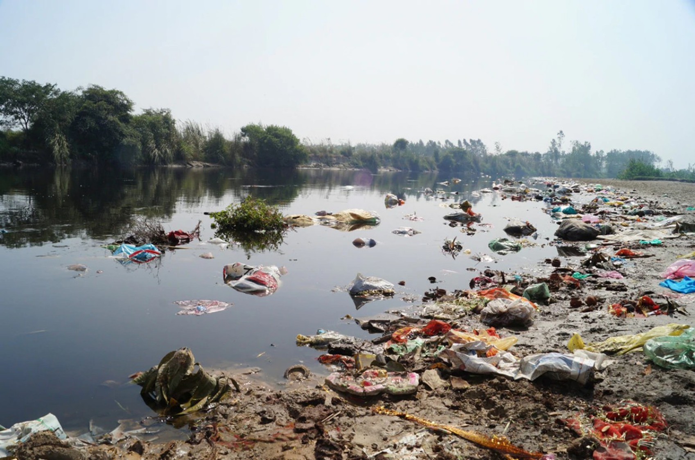
Is this a healthy river?
TAITH
AFON

Slide 6
Ai afon iach yw hon?
TAITH
AFON

Slide 7
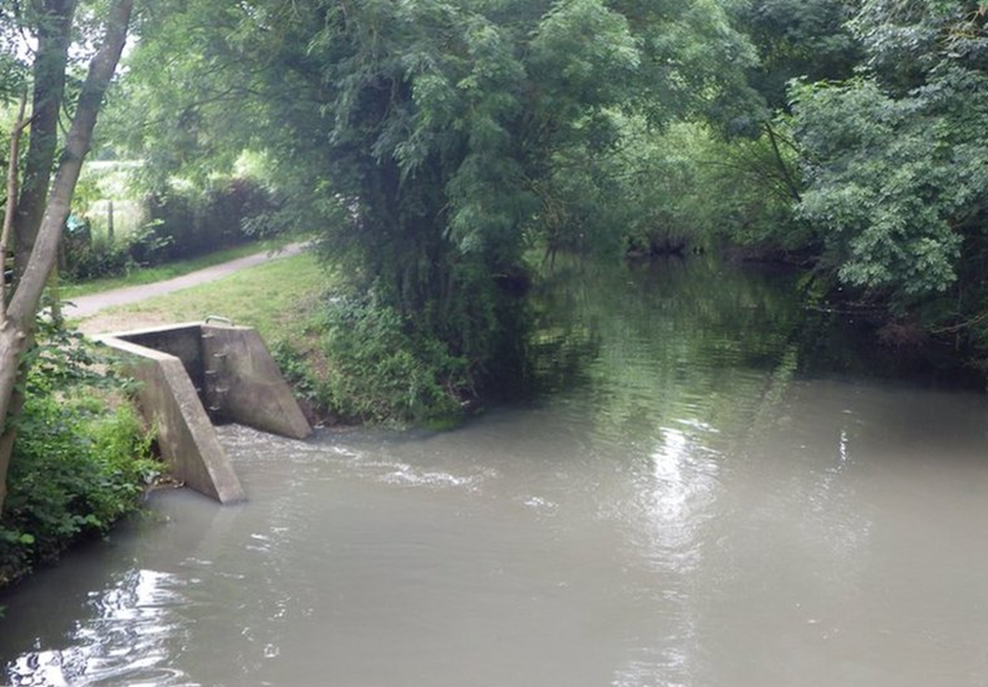
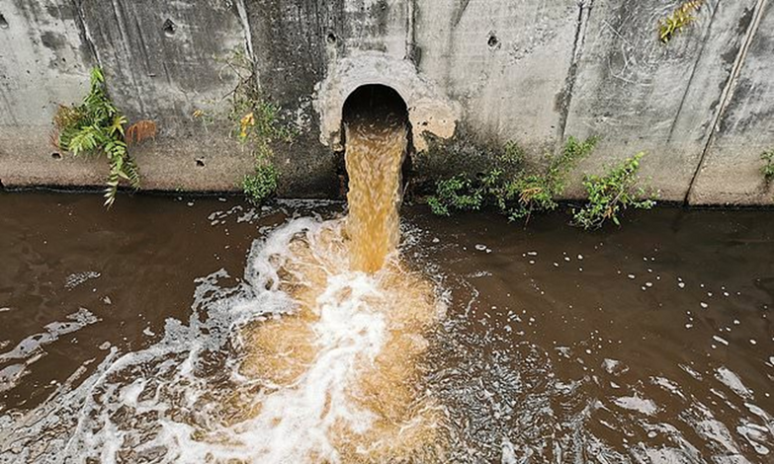
Is this a healthy river?
TAITH
AFON

Slide 8
Ai afon iach yw hon?
TAITH
AFON

Slide 9
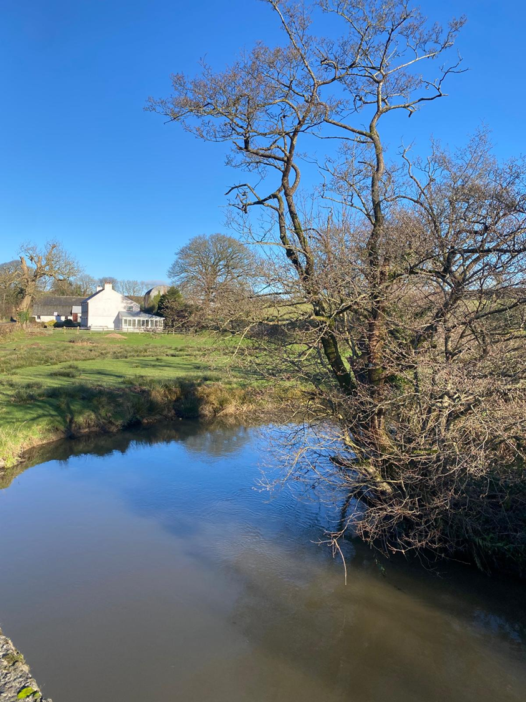
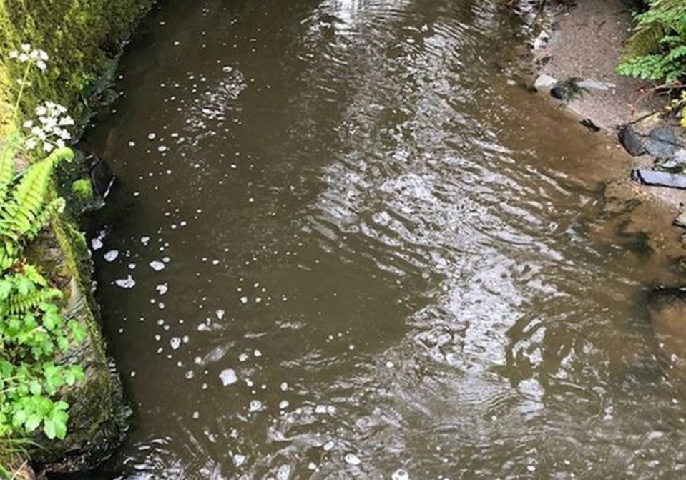
Is this a healthy river?
TAITH
AFON

Slide 10
Ai afon iach yw hon?
TAITH
AFON

Slide 11
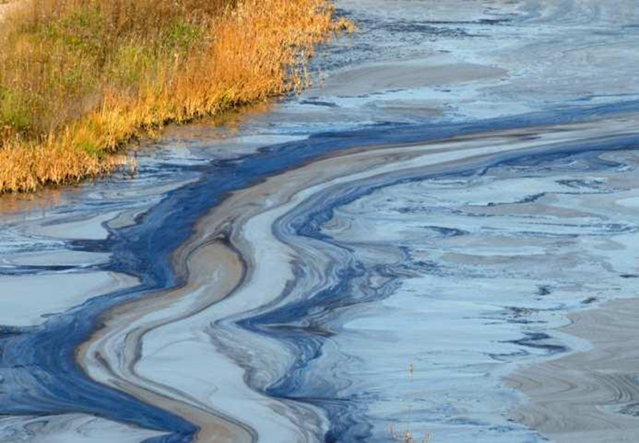
Is this a healthy river?
TAITH
AFON

Slide 12
Ai afon iach yw hon?
TAITH
AFON

Slide 13
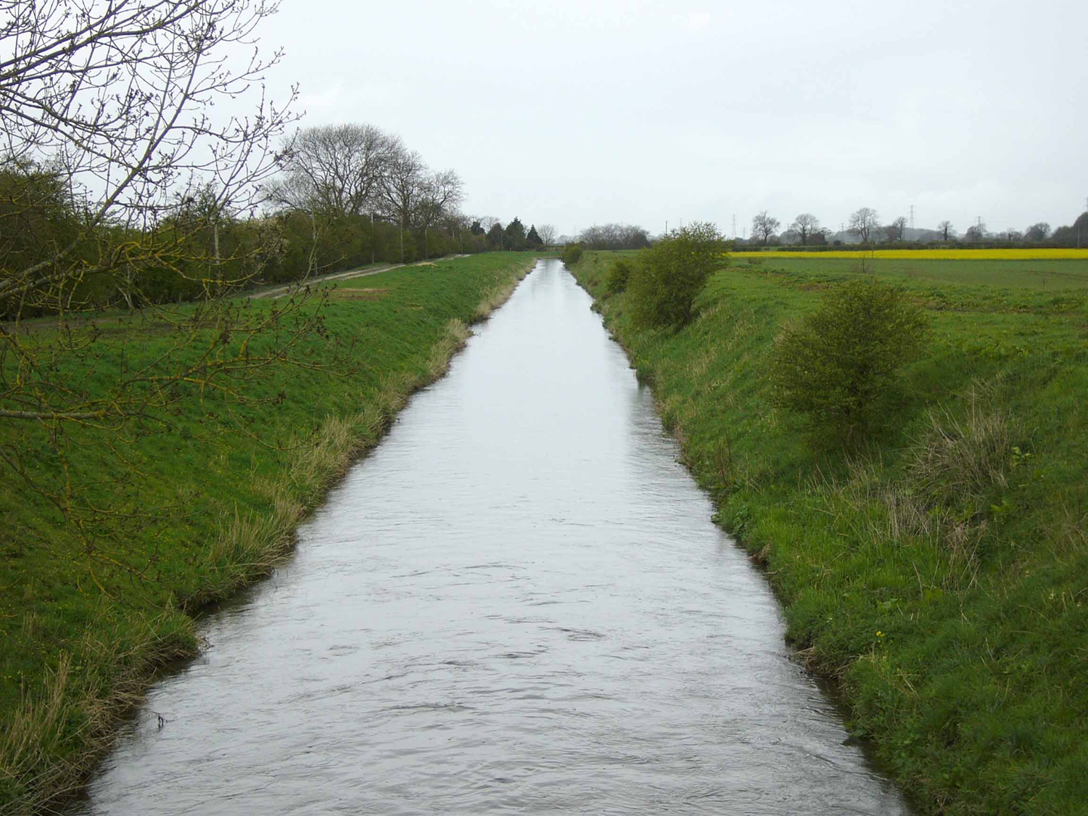
Is this a healthy river?
TAITH
AFON

Slide 14
Ai afon iach yw hon?
TAITH
AFON

Slide 15
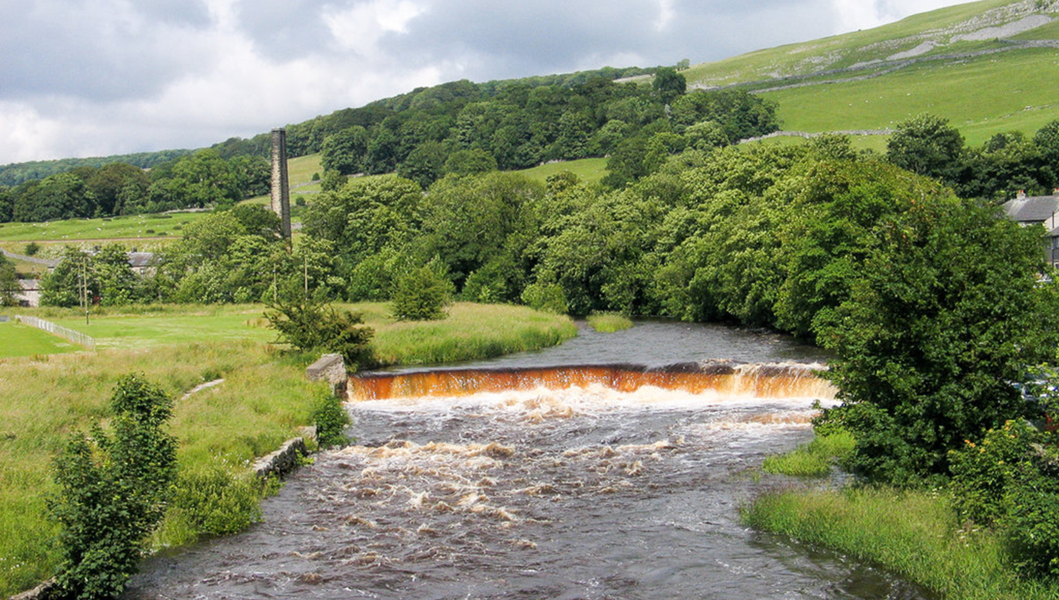
Is this a healthy river?
TAITH
AFON

Slide 16
Ai afon iach yw hon?
TAITH
AFON

Slide 17
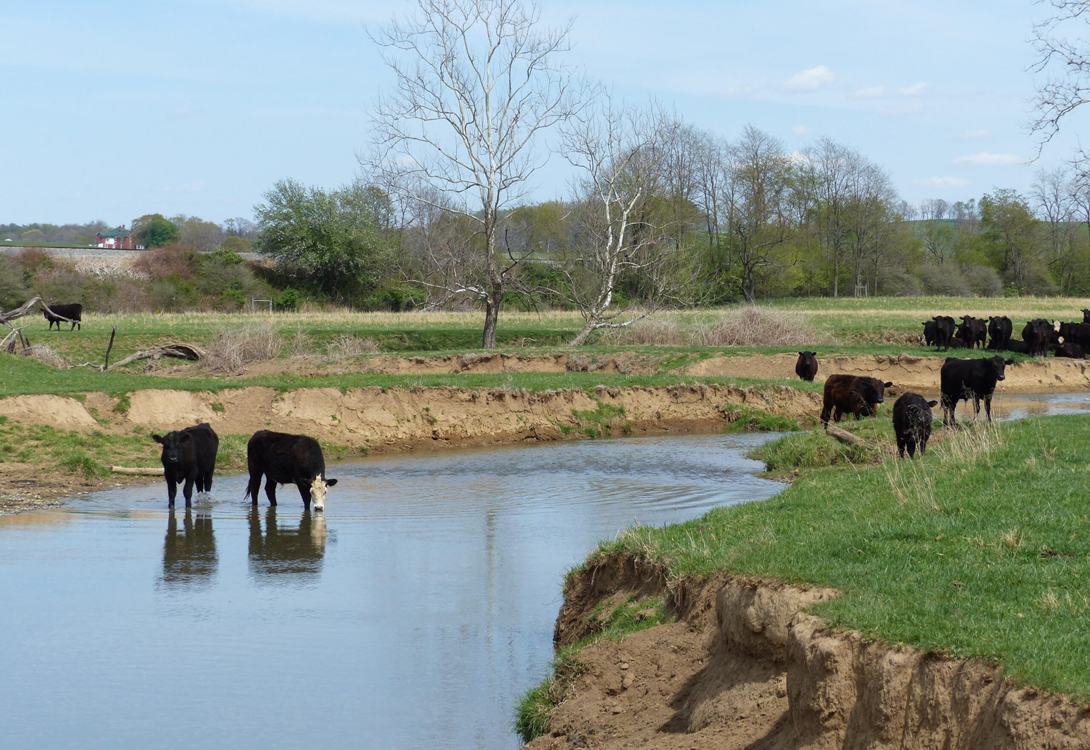
Is this a healthy river?
TAITH
AFON

Slide 18
Ai afon iach yw hon?
TAITH
AFON

Slide 19
ACTIVITY
TAITH
AFON
Its time for you to protect your river...

Slide 20
GWEITHGAREDD
TAITH
AFON
Mae’n amser i chi amddiffyn eich afon...

