Slide 1



TAITH
AFON
RIVER ECOSYSTEMS
WORKSHOP SLIDES

Slide 2
TAITH
AFON
ECOSYSTEM AFON
DEUNYDD GWEITHDY

Slide 3
TAITH
AFON
BY THE END OF THIS WORKSHOP, WE WILL...
Visually identify some river species
Understand the life-cycle of some key river species
Understand how species are connected to create our river ecosystem

Slide 4
TAITH
AFON
ERBYN DIWEDD Y GWEITHDY, BYDDWN YN...
Adnabod rhai o rywogaethau afonydd yn weledol
Deall y gylchred bywyd rhai o rywogaethau allweddol yr afon
Deall sut mae rhywogaethau yn gysylltiedig i greu ecosystem ein hafon.

Slide 5
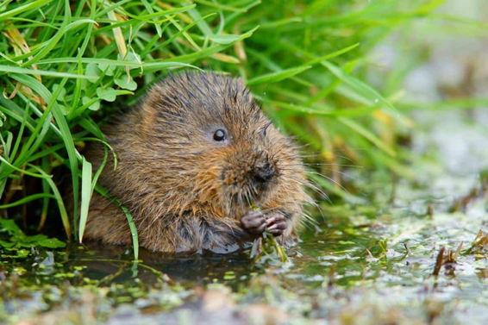
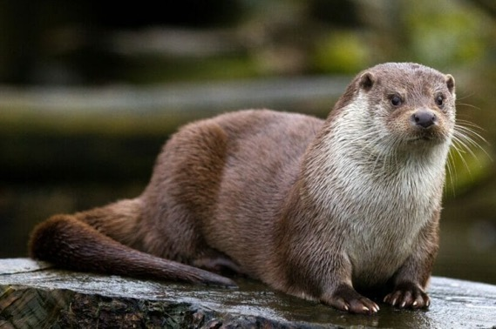
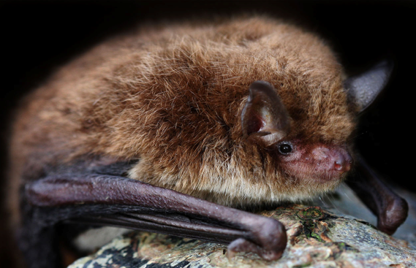
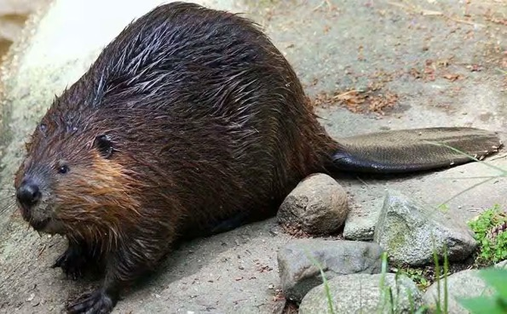
MAMMALS
TAITH
AFON

Slide 6
MAMALIAID
TAITH
AFON

Slide 7
MAMMALS
TAITH
AFON
WATER VOLE

Slide 8
MAMALIAID
TAITH
AFON
LLYGODEN Y DŴR

Slide 9
MAMMALS
TAITH
AFON
EURASIAN OTTER

Slide 10
MAMALIAID
TAITH
AFON
DYFRGI EWRASIAIDD

Slide 11
MAMMALS
TAITH
AFON
DAUBENTONS BAT

Slide 12
MAMALIAID
TAITH
AFON
YSTLUM DAUBENTON

Slide 13
MAMMALS
TAITH
AFON
EURASIAN BEAVER

Slide 14
MAMALIAID
TAITH
AFON
AFANC EWRASIAIDD

Slide 15
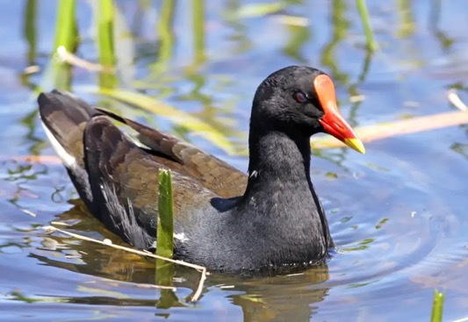
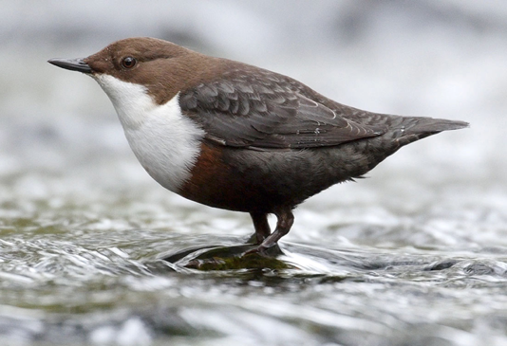
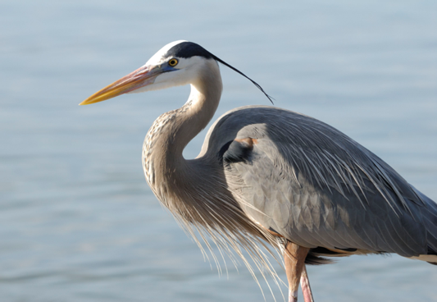
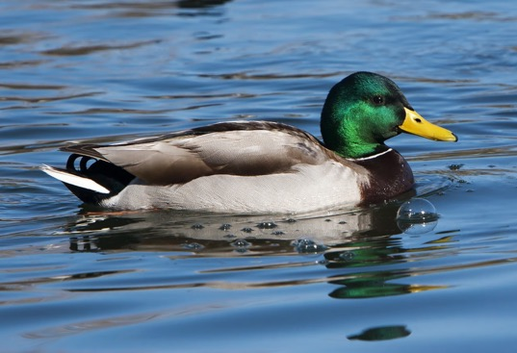
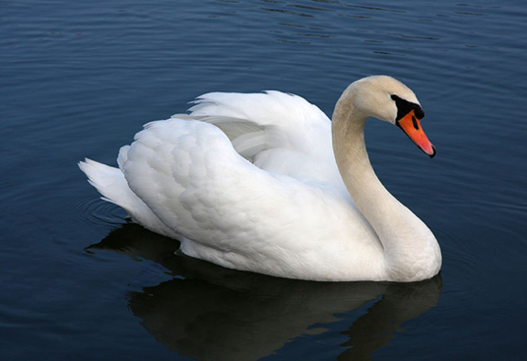
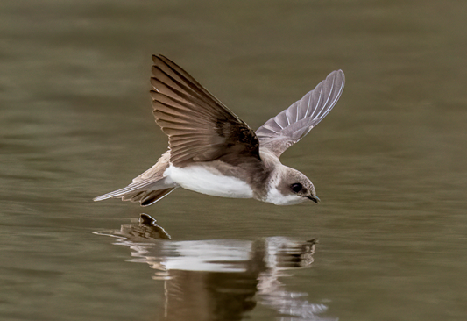
BIRDS
TAITH
AFON

Slide 16
ADAR
TAITH
AFON

Slide 17
BIRDS
TAITH
AFON
COMMON MOORHEN

Slide 18
ADAR
TAITH
AFON
CWTIAR GYFFREDIN

Slide 19
BIRDS
TAITH
AFON
DIPPER

Slide 20
ADAR
TAITH
AFON
TROCHWR

Slide 21
BIRDS
TAITH
AFON
GREY HERON

Slide 22
ADAR
TAITH
AFON
CRËYR GLAS

Slide 23
BIRDS
TAITH
AFON
MALLARD DUCK

Slide 24
ADAR
TAITH
AFON
HWYADEN WYLLT

Slide 25
BIRDS
TAITH
AFON
MUTE SWAN

Slide 26
ADAR
TAITH
AFON
ALARCH DOF

Slide 27
BIRDS
TAITH
AFON
SAND MARTIN

Slide 28
ADAR
TAITH
AFON
GWENNOL Y TYWOD

Slide 29
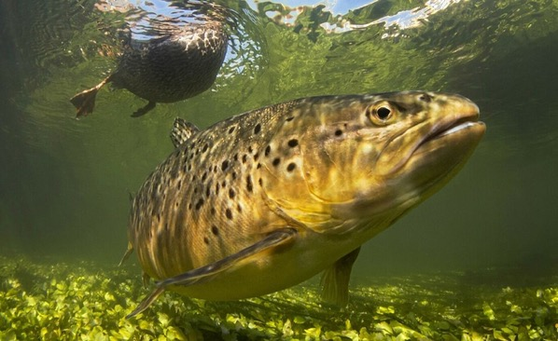
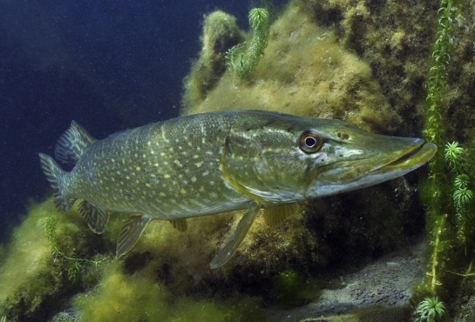
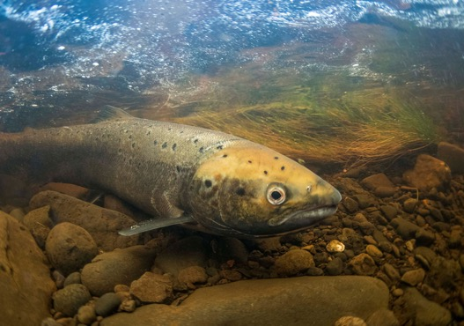
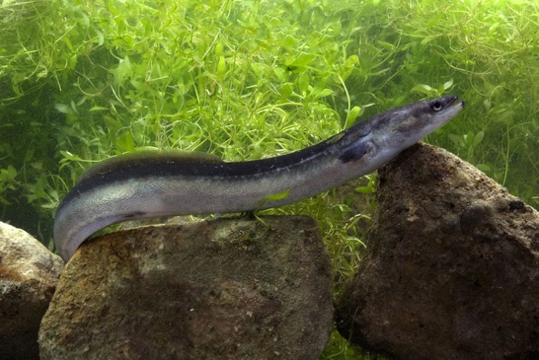
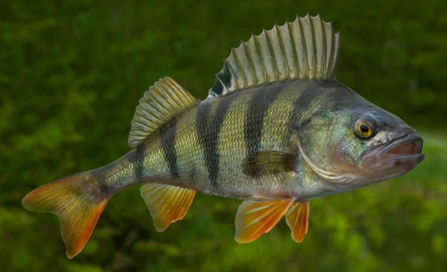
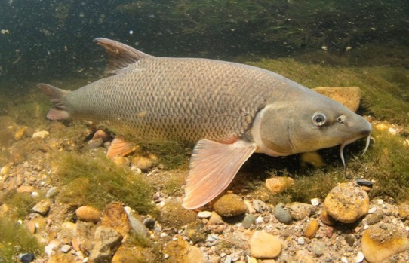
FISH
TAITH
AFON

Slide 30
PYSGOD
TAITH
AFON

Slide 31
FISH
TAITH
AFON
BROWN TROUT

Slide 32
PYSGOD
TAITH
AFON
BRITHYLL BROWN

Slide 33
FISH
TAITH
AFON
PIKE

Slide 34
PYSGOD
TAITH
AFON
PENHWYAD

Slide 35
FISH
TAITH
AFON
ATLANTIC SALMON

Slide 36
PYSGOD
TAITH
AFON
EOG YR IWERYDD

Slide 37
FISH
TAITH
AFON
EUROPEAN EEL

Slide 38
PYSGOD
TAITH
AFON
LLYSYWEN EWROPEAIDD

Slide 39
FISH
TAITH
AFON
PERCH

Slide 40
PYSGOD
TAITH
AFON
DRAENOG

Slide 41
FISH
TAITH
AFON
BARBEL

Slide 42
PYSGOD
TAITH
AFON
BARFOGYN

Slide 43
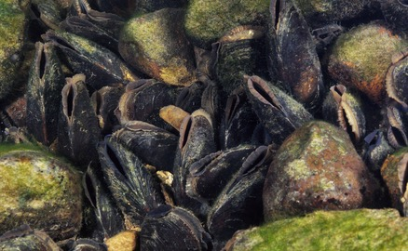
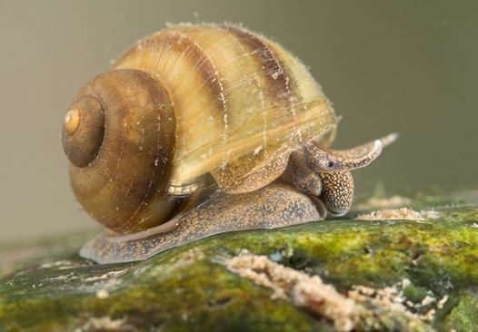
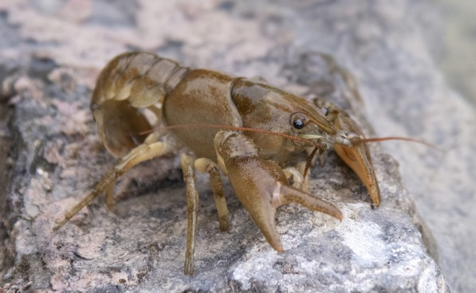
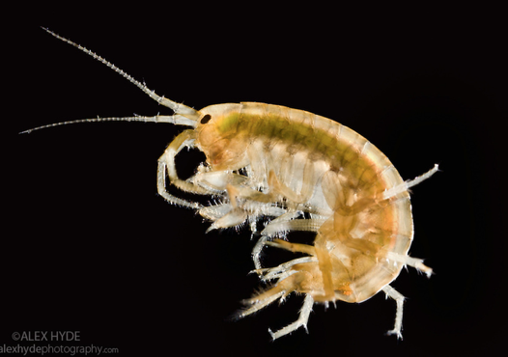
MOLLUSCS AND CRUSTACEANS
TAITH
AFON

Slide 44
MOLYSGIAID A CHRAMENOGION
TAITH
AFON

Slide 45
MOLLUSCS AND CRUSTACEANS
TAITH
AFON
FRESHWATER PEARL MUSSELS

Slide 46
MOLYSGIAID A CHRAMENOGION
TAITH
AFON
CREGYN GLEISION PERL DŴR CROYW

Slide 47
MOLLUSCS AND CRUSTACEANS
TAITH
AFON
FRESHWATER SNAIL

Slide 48
MOLYSGIAID A CHRAMENOGION
TAITH
AFON
MALWODEN DŴR CROYW

Slide 49
MOLLUSCS AND CRUSTACEANS
TAITH
AFON
WHITE CLAWED CRAYFISH

Slide 50
MOLYSGIAID A CHRAMENOGION
TAITH
AFON
CIMWCH AFON CRAFANC WEN

Slide 51
MOLLUSCS AND CRUSTACEANS
TAITH
AFON
FRESHWATER SHRIMP

Slide 52
MOLYSGIAID A CHRAMENOGION
TAITH
AFON
PERDYSYN DŴR CROYW

Slide 53
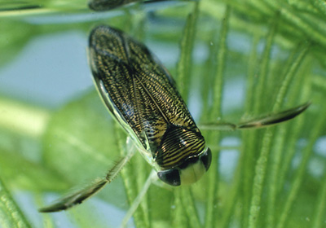
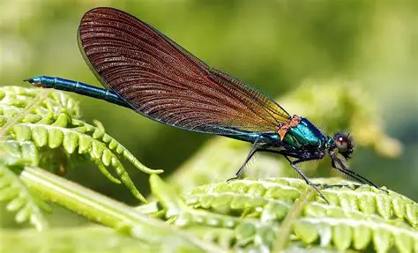
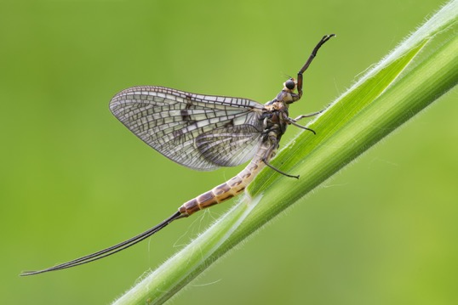
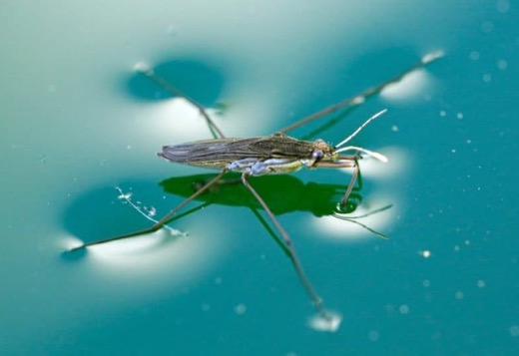
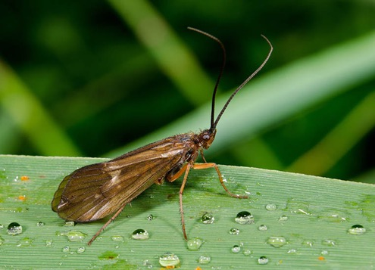
INVERTEBRATES
TAITH
AFON

Slide 54
INFERTEBRATAU
TAITH
AFON

Slide 55
INVERTEBRATES
TAITH
AFON
WATER BOATMAN

Slide 56
INFERTEBRATAU
TAITH
AFON
BADWR Y DŴR

Slide 57
INVERTEBRATES
TAITH
AFON
DRAGONFLY

Slide 58
INFERTEBRATAU
TAITH
AFON
GWAS Y NEIDR

Slide 59
INVERTEBRATES
TAITH
AFON
MAYFLY

Slide 60
INFERTEBRATAU
TAITH
AFON
GWYBEDYN MAI

Slide 61
INVERTEBRATES
TAITH
AFON
POND SKATER

Slide 62
INFERTEBRATAU
TAITH
AFON
RHIAIN Y DŴR

Slide 63
INVERTEBRATES
TAITH
AFON
CADDISFLY

Slide 64
INFERTEBRATAU
TAITH
AFON
PRYD PRIC

Slide 65
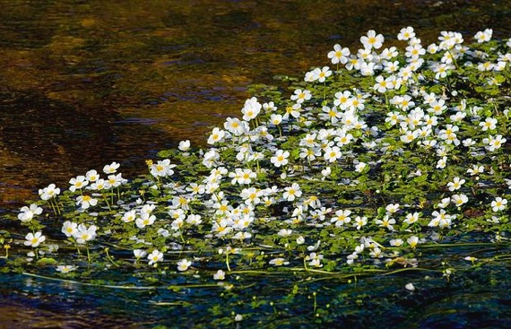
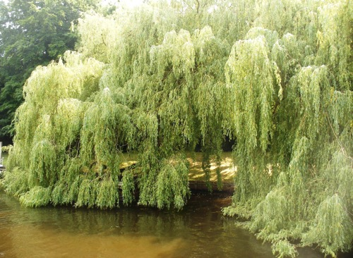
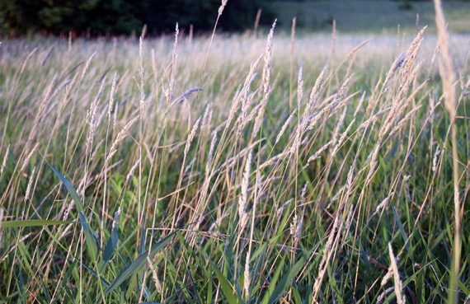
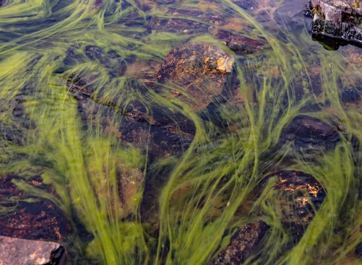
PLANTS
TAITH
AFON

Slide 66
PLANHIGION
TAITH
AFON

Slide 67
PLANTS
TAITH
AFON
WATER CROWFOOT

Slide 68
PLANHIGION
TAITH
AFON
CRAFANC Y DŴR

Slide 69
PLANTS
TAITH
AFON
WHITE WILLOW

Slide 70
PLANHIGION
TAITH
AFON
HELYGEN WYN

Slide 71
PLANTS
TAITH
AFON
COMMON REED

Slide 72
PLANHIGION
TAITH
AFON
CORSEN GYFFREDIN

Slide 73
PLANTS
TAITH
AFON
ALGAE

Slide 74
PLANHIGION
TAITH
AFON
ALGA

Slide 75

LIFECYCLES
TAITH
AFON
SALMON
5-minute task

Slide 76
CYLCH BYWYD
TAITH
AFON
EOG
5-minute task

Slide 77

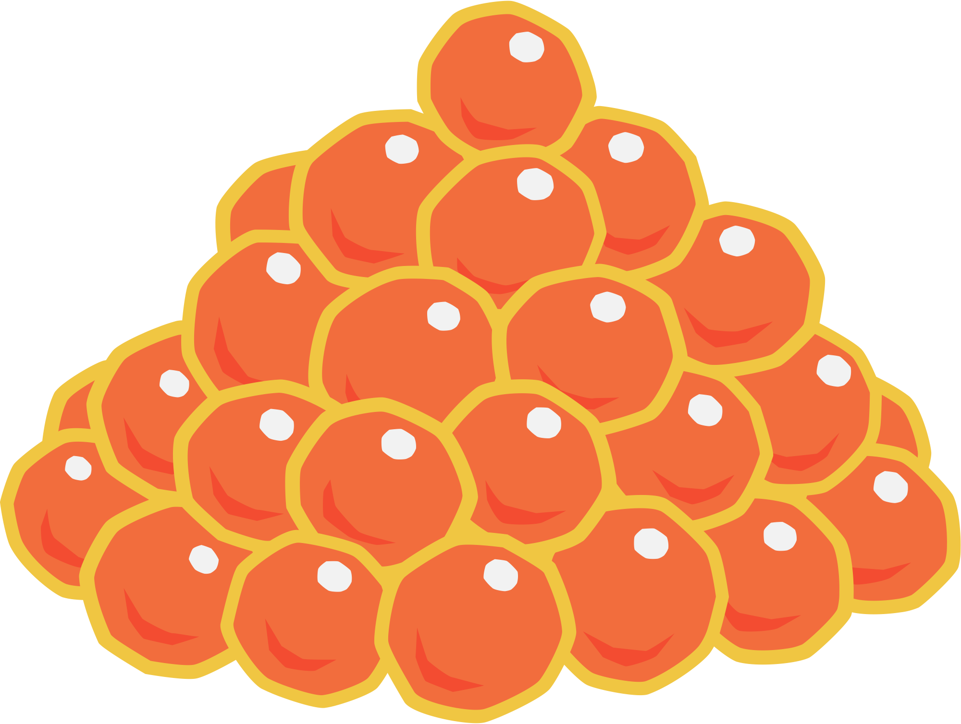


SALMON
TAITH
AFON
SPAWNING SALMON
ADULT SALMON
SALMON LIFE CYCLE
EGGS
SMOLT
ALEVIN
FRY

Slide 78
EOG
TAITH
AFON
MARANEDD
EOG CYFLAWN DWF
CYLCH BYWYD EOG
WYAU
GLEISIAD
ALEFIN
SIL

Slide 79
LIFECYCLES
TAITH
AFON
MAYFLY
5-minute task

Slide 80
CYLCH BYWYD
TAITH
AFON
GWYBEDYN MAI
5-minute task

Slide 81
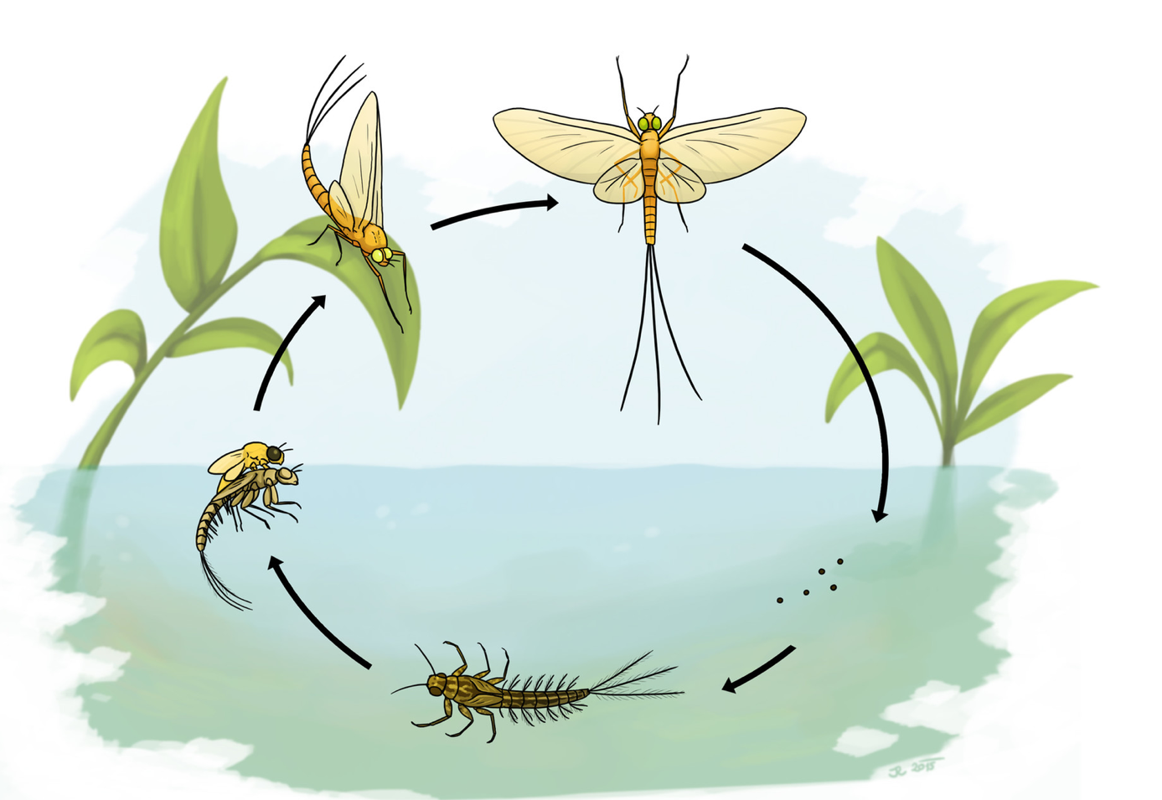
MAYFLY
TAITH
AFON
ADULT SPINNER
ADULT DUN
MAYFLY LIFE CYCLE
EMERGER
EGGS
NYMPH

Slide 82
GWYBEDYN MAI
TAITH
AFON
TROELLWR CYFLAWNDWF
DUN CYFLAWNDWF
CYLCH BYWYD GWYBEDYN MAI
AMGYLCHWR
WYAU
NYMFF

Slide 83

FOOD CHAINS
TAITH
AFON
HOW MANY CAN YOU MAKE?
10-minute task

Slide 84
CADWYN FWYD
TAITH
AFON
FAINT GALLWCH CHI EI WNEUD?
10-minute task

Slide 85
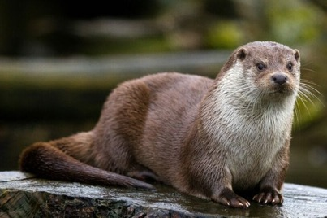


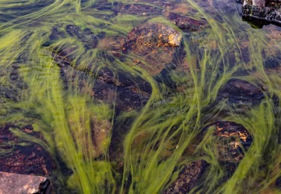

FOOD CHAIN EXAMPLE
TAITH
AFON

Slide 86
ENGHRAIFFT O GADWYN FWYD
TAITH
AFON

Slide 87

FOOD CHAIN EXAMPLE
TAITH
AFON
ARROWS SHOW THE MOVEMENT OF ENERGY, NOT WHO EATS WHO!

Slide 88
ENGHRAIFFT O GADWYN FWYD
TAITH
AFON
ARROWS SHOW THE MOVEMENT OF ENERGY, NOT WHO EATS WHO!

Slide 89

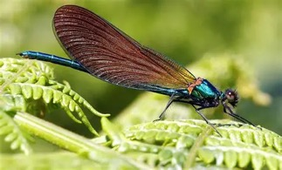







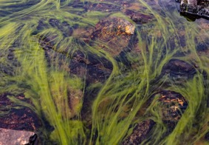
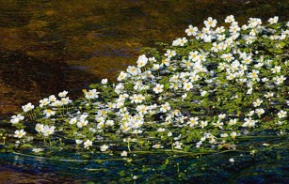



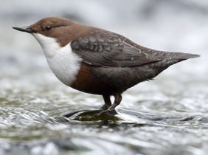
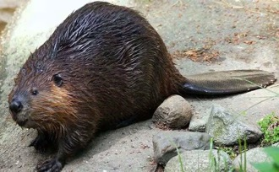


OUR RIVER ECOSYSTEM
TAITH
AFON

Slide 90
ECOSYSTEM EIN HAFON
TAITH
AFON

Slide 91
Stretch Activity
TAITH
AFON
Use the information around the room on the following topics to fill in your river research log.
Overfishing
Algal Overgrowth
Beaver Culling
Oil Spill
ARROWS SHOW THE MOVEMENT OF ENERGY, NOT WHO EATS WHO!

Slide 92
Gweithgaredd Ymestyn
TAITH
AFON
Defnyddiwch y wybodaeth o amgylch yr ystafell ar y testunau olynol er mwyn cwblhau loglyfr ymchwil eich afon.
Gorbysgotta
Gordyfiant Alga
Difa Afancod
Arllwysiad Olew
ARROWS SHOW THE MOVEMENT OF ENERGY, NOT WHO EATS WHO!

Slide 93
RIVER ECOSYSTEM –Print outs
Print the following slides, 1x per A4 and laminate to use in the next Activity.

Slide 94
ECOSYSTEM AFON – Deunydd Argraffu
Argraffwch y deunydd olynol, 1 x i bob darn A4 a lamineiddio er mwyn ei ddefnyddio yn y gweithgaredd nesaf.

